Slide 1

50.039 Theory and Practice of Deep Learning W12-S1 Interpretability in Deep Learning
Matthieu De Mari

Slide 2
About this week (Week 12, an informative lecture about interpretability and AI ethics)
What is interpretability and why is it necessary?
What are typical examples of models mistakes and biases?
What are the two great families of algorithms for interpretability?
What is the t-SNE algorithm and how can it help to interpret a model?
What is the activation maximization algorithm?
What are occlusion-based approaches?
What are gradient-based approaches for interpretability and their limits?
(What is the LIME algorithm?)
(What is the guided backpropagation algorithm?)
(What is the LRP algorithm?)
(What are open questions in research in interpretability?)

Slide 3
What is interpretability? (or eq. Explainability)
Definition (Interpretability in Neural Networks):
Interpretability is the degree to which a human can understand the cause of a decision, i.e. the degree to which a human can consistently predict the model's result.
The higher the interpretability of a machine learning model, the easier it is for someone to comprehend why certain decisions or predictions have been made.
Typically, a model is more interpretable than another model if its decisions are easier for a human to comprehend than decisions from the other model.

Slide 4
Why do we need interpretability?
There are many reasons why we need interpretability.
Reason #1: Because humans are easily scared by things they do not understand and do not like things that are not easily explainable.
Reason #2: Improving Neural Networks decisions and training methods.
Reason #3: Confirming what a Neural Network has learnt and what it seems to implement to reach a decision.
Reason #4: Identify the reasons for mistakes and cognitive biases in the decisions of a Neural Network in an attempt to fix them.

Slide 5


Reason #1: Because humans do not like things that are not easily explainable.
https://www.vice.com/en/article/7x48kg/the-divide-between-people-who-hate-and-love-artificial-intelligence-is-not-real
https://theconversation.com/people-dont-trust-ai-heres-how-we-can-change-that-87129

Slide 6

Reason #1: Because humans do not like things that are not easily explainable.
https://www.vice.com/en/article/7x48kg/the-divide-between-people-who-hate-and-love-artificial-intelligence-is-not-real
https://theconversation.com/people-dont-trust-ai-heres-how-we-can-change-that-87129

Slide 7
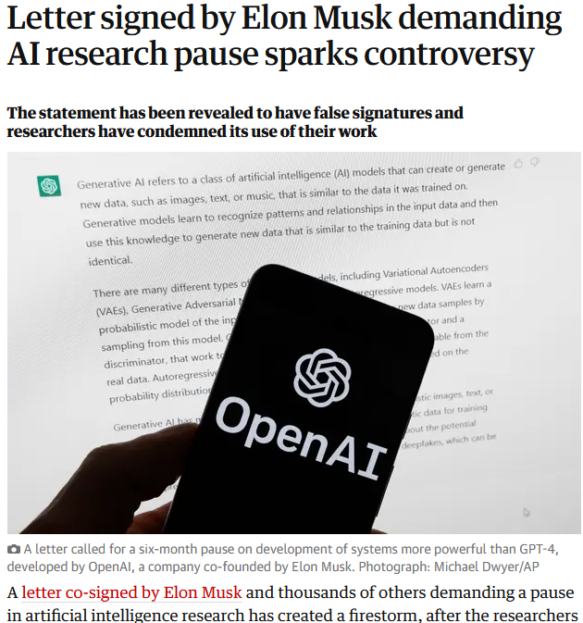
Reason #1: Because humans do not like things that are not easily explainable.
https://www.vice.com/en/article/7x48kg/the-divide-between-people-who-hate-and-love-artificial-intelligence-is-not-real
https://theconversation.com/people-dont-trust-ai-heres-how-we-can-change-that-87129

Slide 8
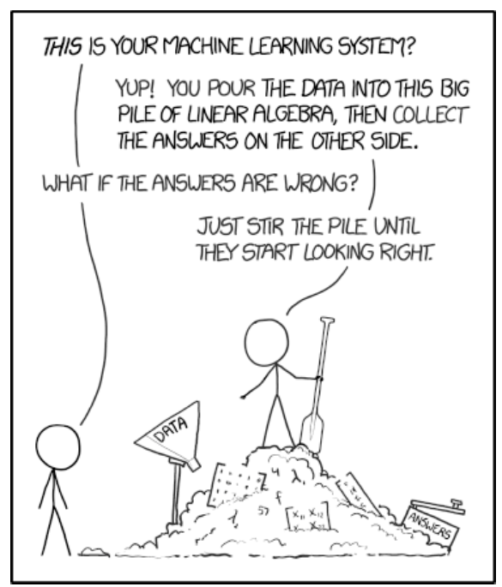
Reason #2
Reason #2: Improving Neural Networks decisions and training methods.
Neural Networks are black-boxes, and a very empirical science.
Experience shows that these algorithms have been able to (partially) answer some problems we had no clue how to address.
But still very obscure…
https://www.explainxkcd.com/wiki/index.php/1838:_Machine_Learning

Slide 9
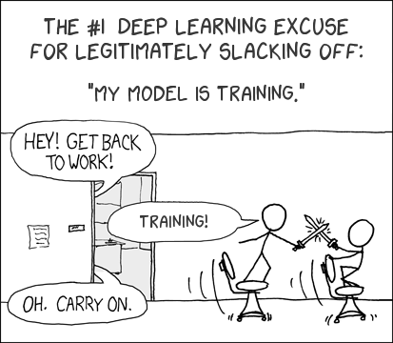
Reason #2
Reason #2: Improving Neural Networks decisions and training methods.
Understanding how NNs tend to learn could lead to more efficient training procedures.
(Right now we kind of pray that an empirically validated model architecture and some Gradient Descent will make it work?)
https://www.explainxkcd.com/wiki/index.php/303:_Compiling

Slide 10
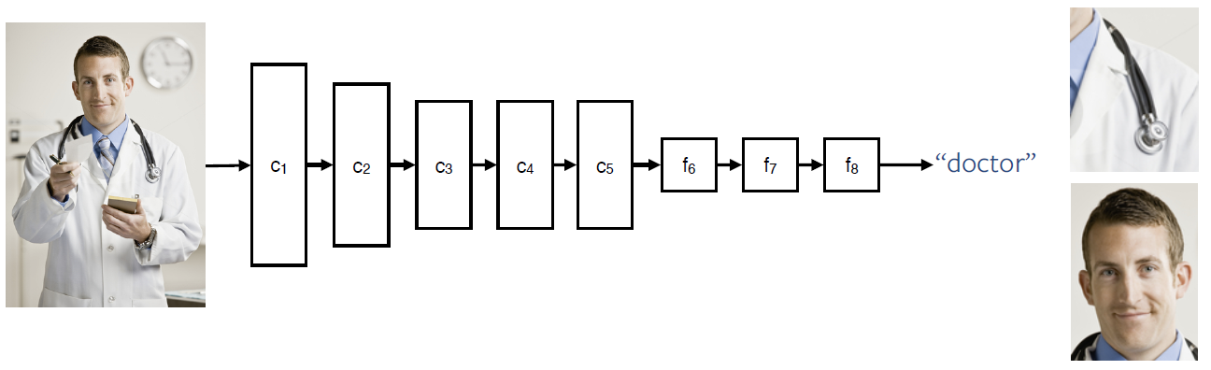
Reason #3
Reason #3: Confirming what a Neural Network has learnt and what it seems to implement to reach a decision.
What features is the neural network learning to reach a decision?
What similarities is the neural network looking for in the dataset?
What are the neurons doing anyway?

Slide 11
Reason #4
Reason #4: Identify the reasons for mistakes and cognitive biases in the decisions of a Neural Network in an attempt to fix them.
Definition (cognitive bias):
Similar to cognitive biases in psychology.
In Neural Networks, a cognitive bias refers to a feature, which has been used by the NN to reach a certain decision, but should not have been used as it seems illogical to humans.

Slide 12
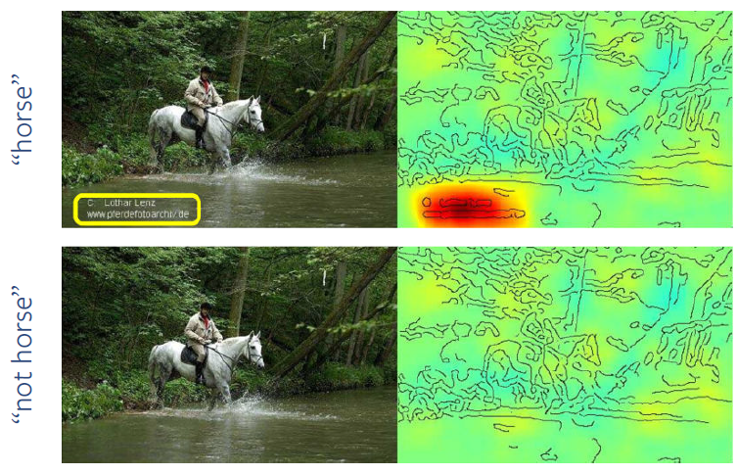
Reason #4
Reason #4: Identify the reasons for mistakes and cognitive biases in the decisions of a Neural Network in an attempt to fix them.
The Neural network on the right draws information from the photo legend and recognizes that this photographer likes to take pictures of horses…
That is a cognitive bias!

Slide 13
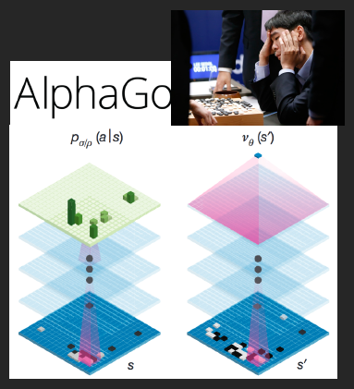
Reason #4
Causality: Check that only causal relationships are picked up. No cognitive biases.

Slide 14
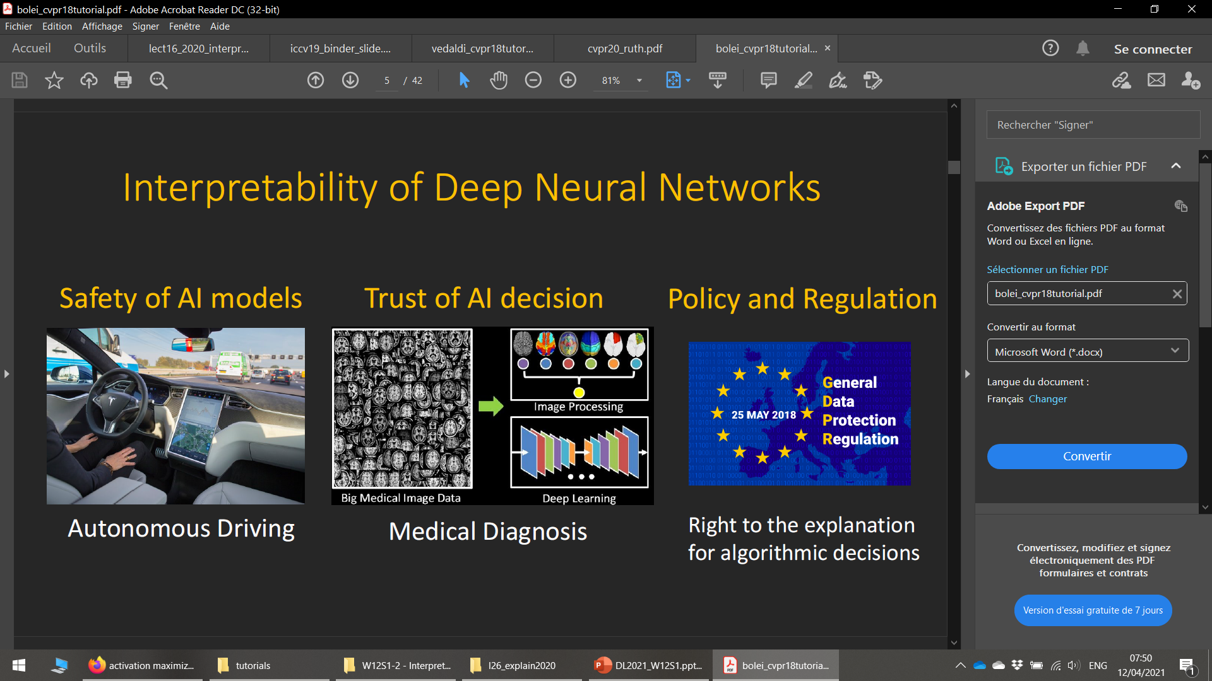

Reason #4
Causality: Check that only causal relationships are picked up. No cognitive biases.

Slide 15
Reason #4
Causality: Check that only causal relationships are picked up. No cognitive biases.
Reliability or Robustness: Ensuring that small changes in the input do not lead to large changes in the prediction.

Slide 16
Reason #4
Causality: Check that only causal relationships are picked up. No cognitive biases.
Reliability or Robustness: Ensuring that small changes in the input do not lead to large changes in the prediction.

Slide 17
Reason #4
Causality: Check that only causal relationships are picked up. No cognitive biases.
Reliability or Robustness: Ensuring that small changes in the input do not lead to large changes in the prediction.
Privacy: Ensuring that sensitive information in the data is protected.

Slide 18
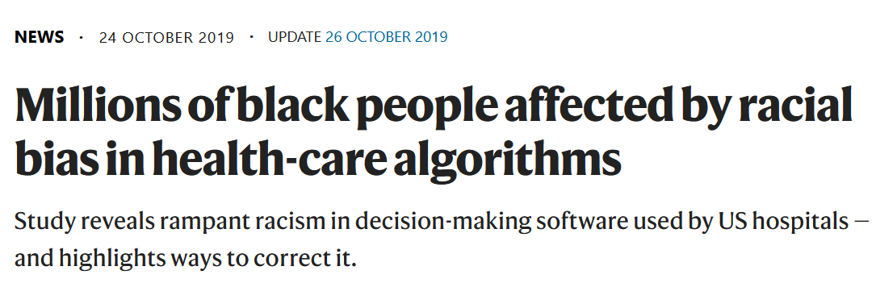

Reason #4
Fairness: Ensuring that predictions are unbiased and do not implicitly or explicitly discriminate against underrepresented groups.
An interpretable model can tell you why it has decided that a certain person should not get a loan, and it becomes easier for a human to judge whether the decision is based on a learned demographic (e.g. racial) bias.
https://www.nature.com/articles/d41586-019-03228-6

Slide 19
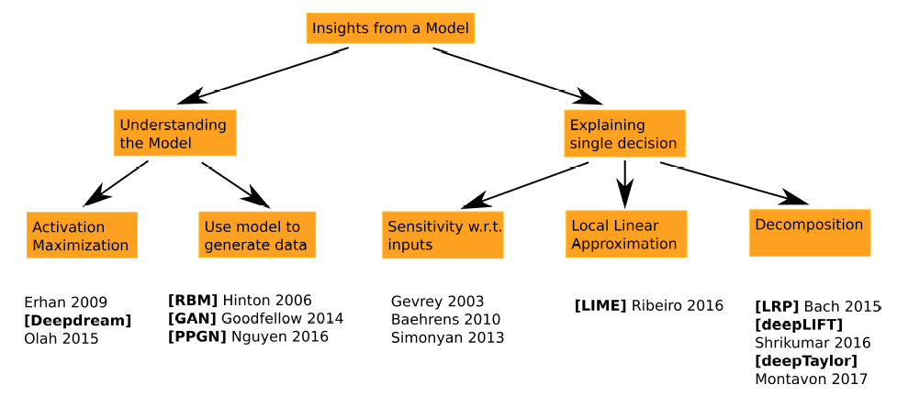
The two families of interpretability methods

Slide 20
The two families of interpretability methods
Explaining a single decision: this first class of methods attempts to understand how the data is interpreted by the model.
Which part of the image is used for the decision?
Which image would maximize this particular class?
Which part of the image would have to be modified to affect the decision?

Slide 21
The two families of interpretability methods
Understanding the model: this second class of methods focuses on understanding the meaning of trained parameters in the models.
What is this neuron computing?
What feature is this convolution filter checking?
Etc.

Slide 22
Methods for explainability
t-SNE
Dataset evaluation
Gradient maps and gradient-input maps
LIME
Occlusion-based methods
Activation maximization on samples
Activation maximization on layers
Guided back-propagation
LRP
Note: we will not have time to explore the implementation of said methods, and that is alright!
Mostly interested in the intuition and general discussion of this topic anyway!

Slide 23

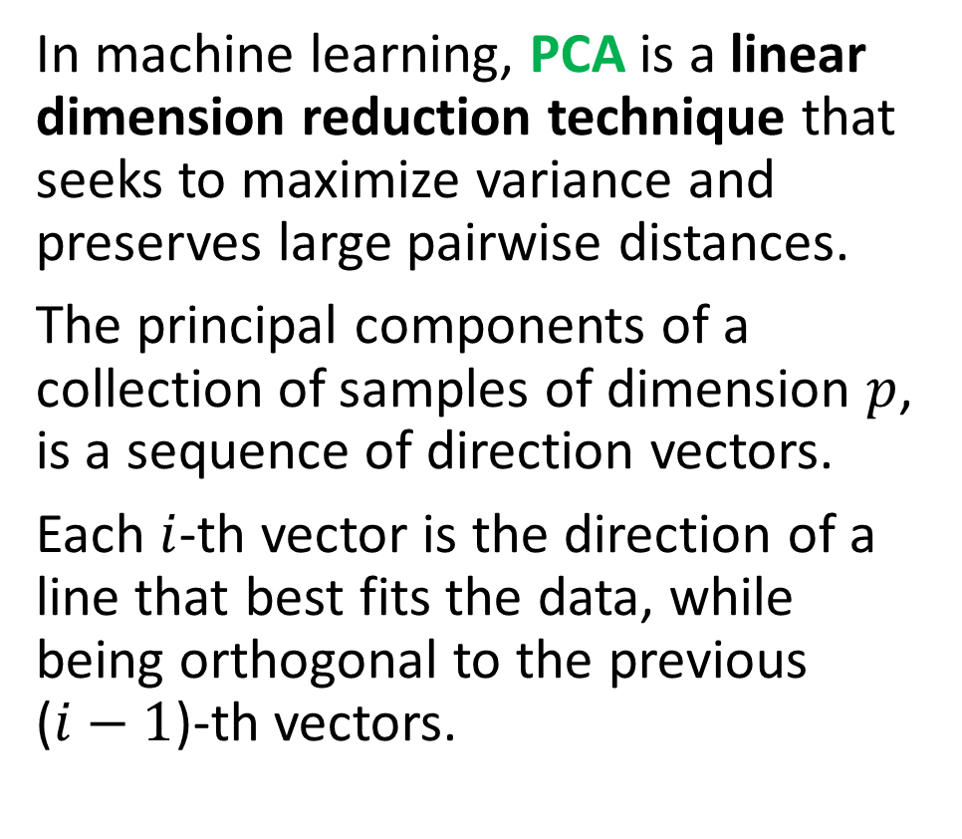
Reminder: Principal Component Analysis (PCA)
In machine learning, PCA is a linear dimension reduction technique that seeks to maximize variance and preserves large pairwise distances.
The principal components of a collection of samples of dimension $p$, is a sequence of direction vectors.
Each $i$-th vector is the direction of a line that best fits the data, while being orthogonal to the previous ($i−1$)-th vectors.

Slide 24
t-SNE, a definition
Definition (t-SNE):
The t-Distributed Stochastic Neighbor Embedding (t-SNE) is an unsupervised, non-linear technique primarily used for data exploration and visualizing high-dimensional data.
In simpler terms, t-SNE gives you a feel or intuition of how the data is arranged in a high-dimensional space.
The t-SNE differs from PCA by preserving only the small pairwise distances or local similarities, whereas PCA is concerned with preserving large pairwise distances to maximize variance.

Slide 25
t-SNE implementation
The t-SNE algorithm calculates a similarity measure between pairs of instances in the high dimensional space and in the low dimensional space.
It then tries to optimize these two similarity measures using a cost function.
Objective: given N datapoints, create N 2-D embeddings according to their similarities.

Slide 26
t-SNE implementation
The t-SNE algorithm calculates a similarity measure between pairs of instances in the high dimensional space and in the low dimensional space.
It then tries to optimize these two similarity measures using a cost function.
Objective: given N datapoints, create N 2-D embeddings according to their similarities.
The t-SNE method can be broken down in three steps.
Step 1: Gaussian distribution between samples in high-dimension space.
Step 2: Cauchy distribution between representations in low-dimension space.
Step 3: Minimize the KL divergence between both distributions.

Slide 27
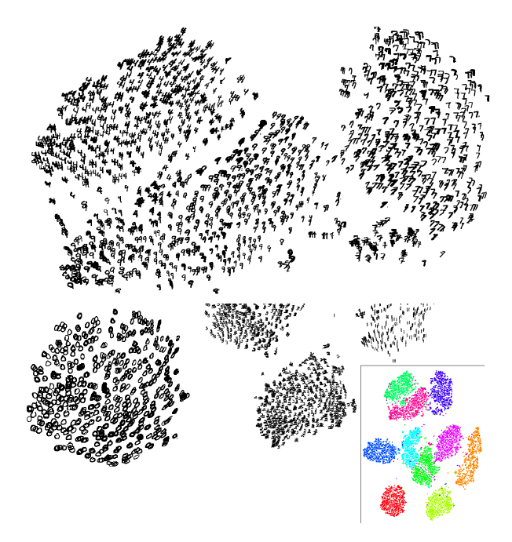

Slide 28
Dos and Don’ts for t-SNE
Do
Use it on your dataset and trained model outputs!
Use t-SNE to get some qualitative hypotheses on what your features capture.
Use t-SNE to get insights as to whether or not the data is appearing as separable in the first place.

Slide 29
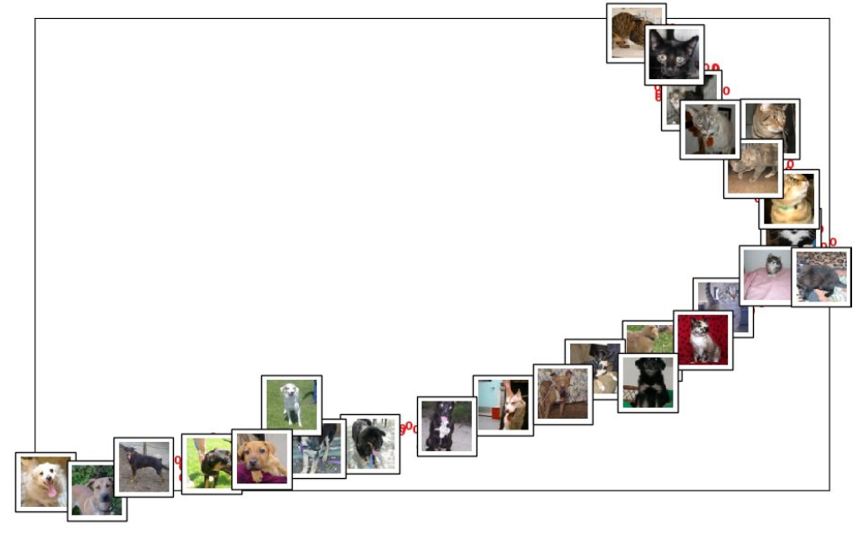

Slide 30
Dos and Don’ts for t-SNE
Do
Use it on your dataset and trained model outputs!
Use t-SNE to get some qualitative hypotheses on what your features capture.
Use t-SNE to get insights as to whether or not the data is appearing as separable in the first place.
Don’t
Present a "proof by t-SNE": your map is not the data!
Attempt to interpret distances between points in the t-SNE visualization.

Slide 31
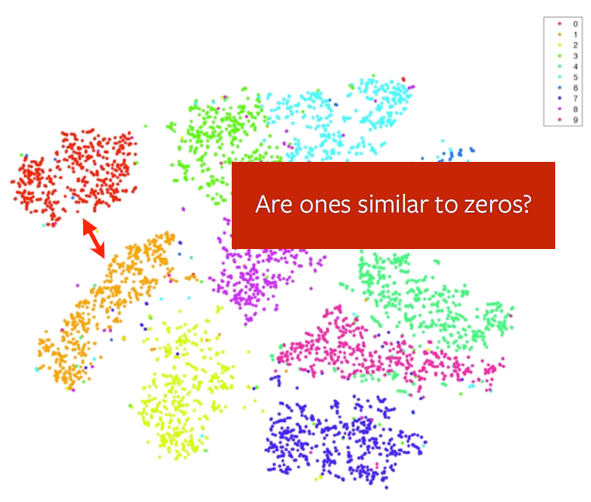
Dos and Don’ts for t-SNE
Do
Use it on your dataset and trained model outputs!
Use t-SNE to get some qualitative hypotheses on what your features capture.
Use t-SNE to get insights as to whether or not the data is appearing as separable in the first place.
Don’t
Present a "proof by t-SNE": your map is not the data!
Attempt to interpret distances between points in the t-SNE visualization.

Slide 32
Dos and Don’ts for t-SNE
Do
Use it on your dataset and trained model outputs!
Use t-SNE to get some qualitative hypotheses on what your features capture.
Use t-SNE to get insights as to whether or not the data is appearing as separable in the first place.
Don’t
Present a "proof by t-SNE": your map is not the data!
Attempt to interpret distances between points in the t-SNE visualization.
Forget that low-dimensional metric spaces cannot capture non-metric similarities.

Slide 33

Dos and Don’ts for t-SNE
Do
Use it on your dataset and trained model outputs!
Use t-SNE to get some qualitative hypotheses on what your features capture.
Use t-SNE to get insights as to whether or not the data is separable in the first place (if not, very little hope to train a classifier!)
Don’t
Present a "proof by t-SNE": your map is not the data!
Attempt to interpret distances between points in the t-SNE visualization.
Forget that low-dimensional metric spaces cannot capture non-metric similarities.

Slide 34
To conclude about t-SNE
The t-SNE method is a valuable tool in visualizing data, generating hypotheses and understanding.
However, it does not produce conclusive evidence.
This is automatically done with libraries such as sklearn.
For instance, see https://scikit-learn.org/stable/modules/generated/sklearn.manifold.TSNE.html)

Slide 35
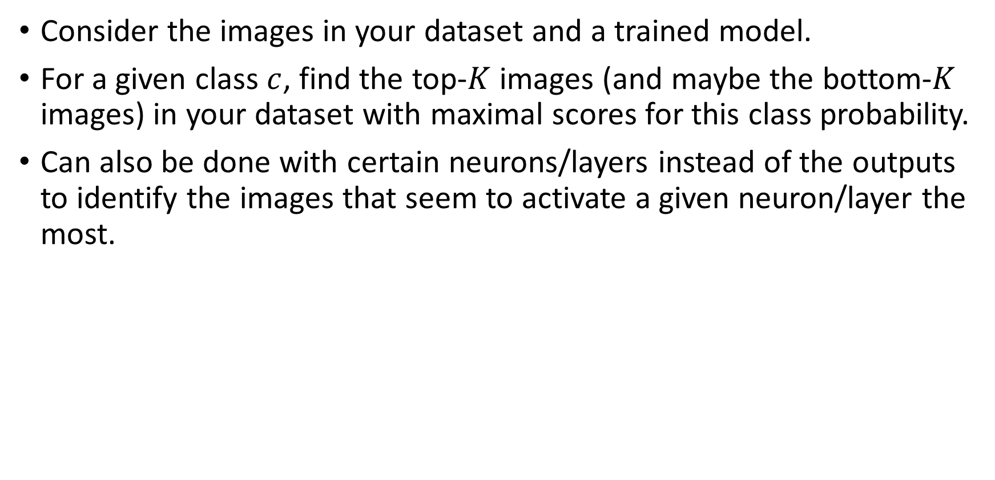
Analyzing features via dataset evaluation
Consider the images in your dataset and a trained model.
For a given class $c$, find the top-$K$ images (and maybe the bottom-$K$ images) in your dataset with maximal scores for this class probability.
Can also be done with certain neurons/layers instead of the outputs to identify the images that seem to activate a given neuron/layer the most.

Slide 36
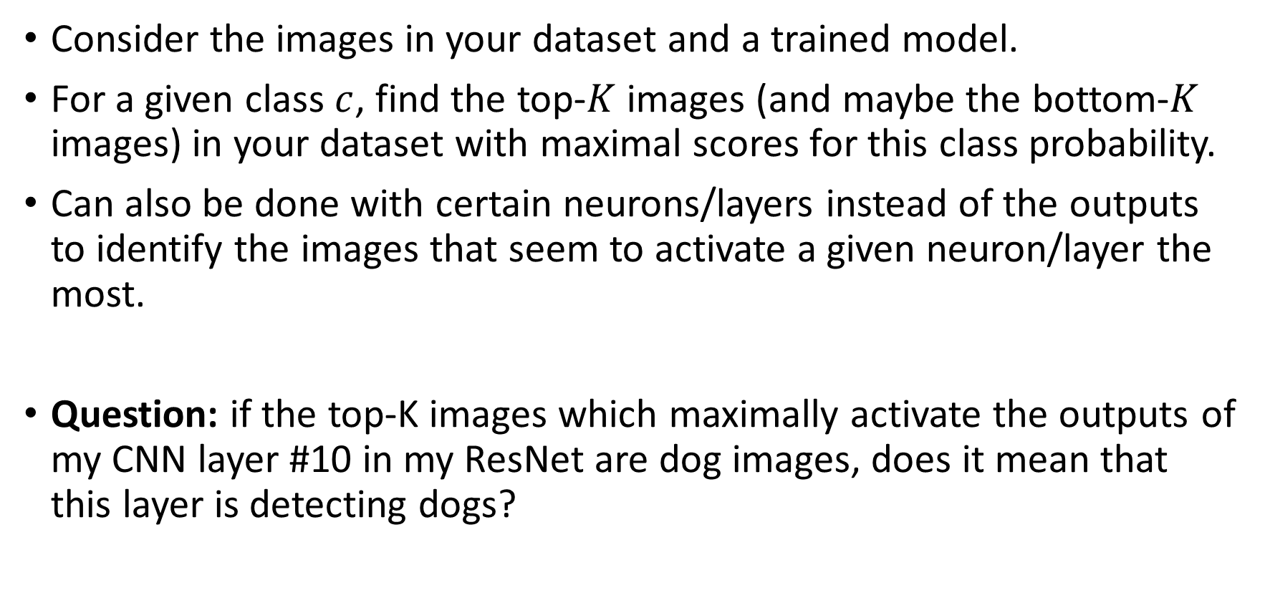
Analyzing features via dataset evaluation
Consider the images in your dataset and a trained model.
For a given class $c$, find the top-$K$ images (and maybe the bottom-$K$ images) in your dataset with maximal scores for this class probability.
Can also be done with certain neurons/layers instead of the outputs to identify the images that seem to activate a given neuron/layer the most.
Question: if the top-K images which maximally activate the outputs of my CNN layer #10 in my ResNet are dog images, does it mean that this layer is detecting dogs?

Slide 37
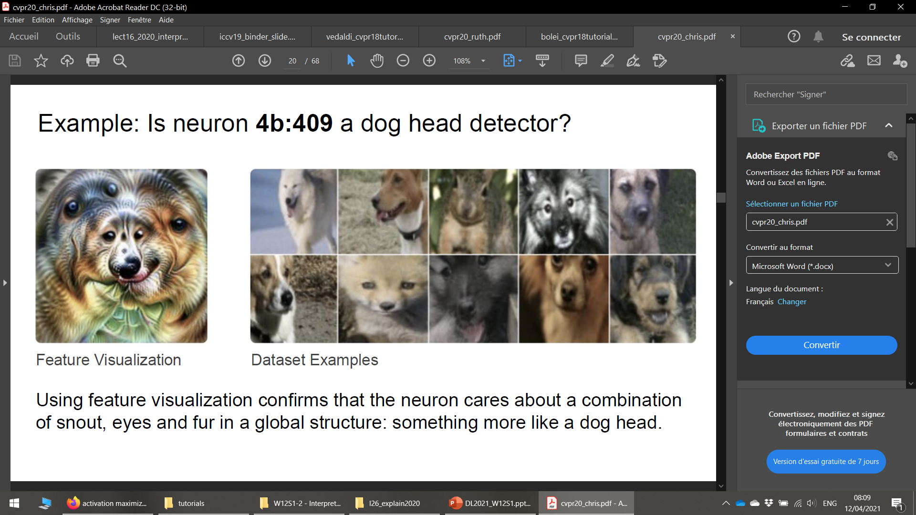
Analyzing features via dataset evaluation
Question: if the top-K images which maximally activate the outputs of my CNN layer #10 in my ResNet are dog images, does it mean that this layer is detecting dogs?

Slide 38
Analyzing features via dataset evaluation
Question: if the top-K images which maximally activate the outputs of my CNN layer #10 in my ResNet are dog images, does it mean that this layer is detecting dogs?
This is simple to implement, but does not show much.
This does not show what features your model has learned.
It simply shows what your model seems to be focusing on in your given dataset.
Need something more sophisticated.

Slide 39
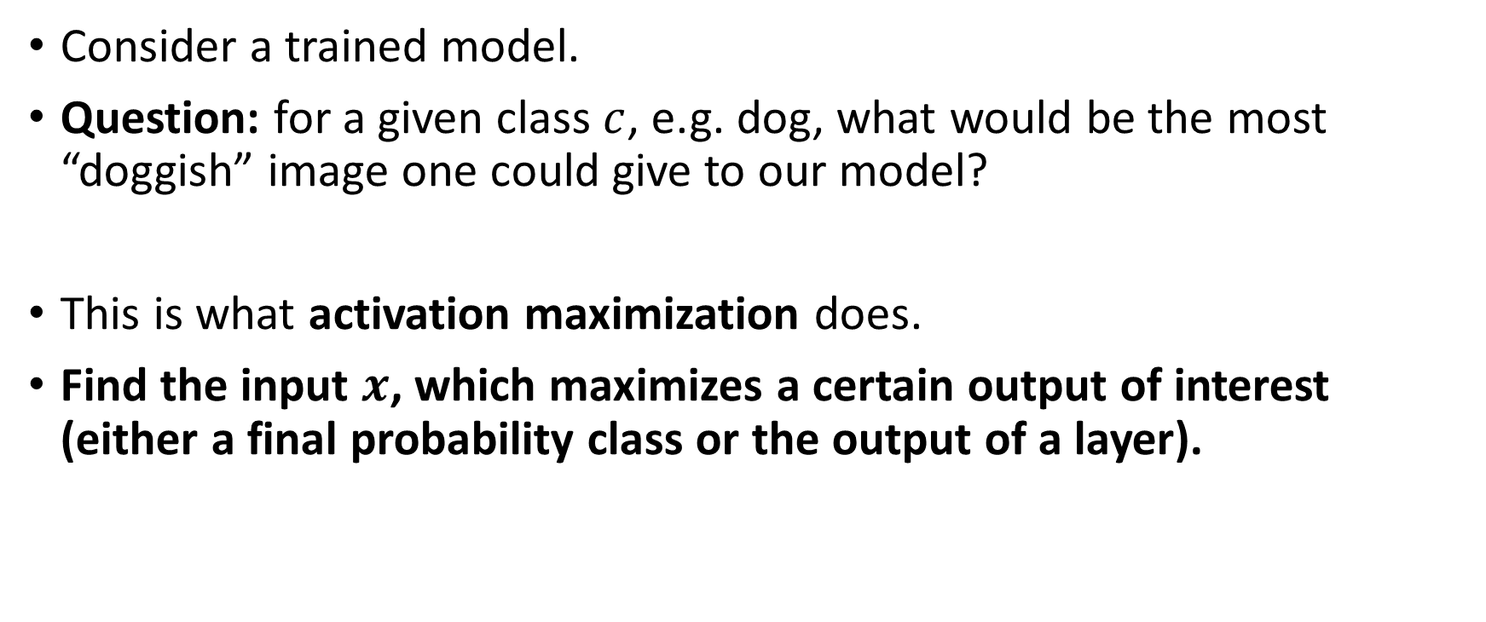
Activation maximization on output classes
Consider a trained model.
Question: for a given class $c$, e.g. dog, what would be the most “doggish” image one could give to our model?
This is what activation maximization does.
Find the input $x$, which maximizes a certain output of interest (either a final probability class or the output of a layer).

Slide 40
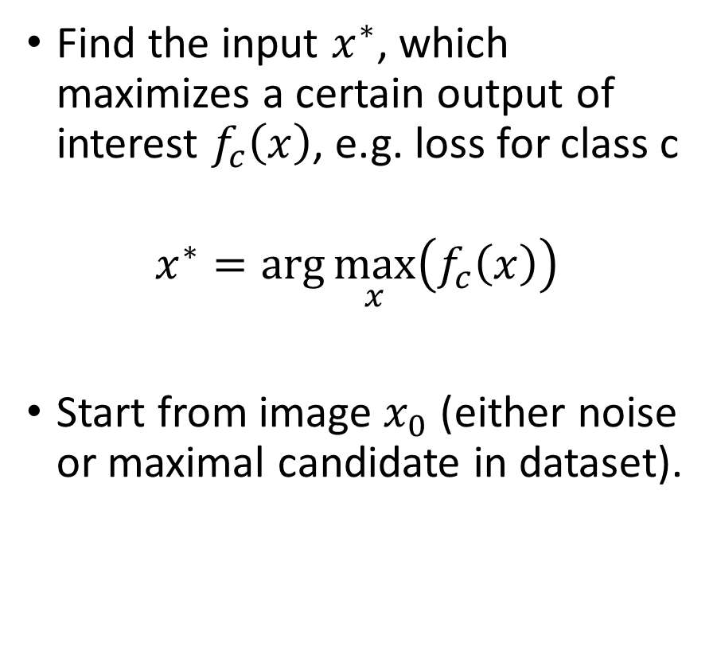
Activation maximization on output classes
Find the input $x^{∗}$, which maximizes a certain output of interest $f_{c}\left(x\right)$, e.g. loss for class c
$$x^{∗}=\arg{\max_{x}\left(f_{c}\left(x\right)\right)}$$
Start from image $x_{0}$ (either noise or maximal candidate in dataset).

Slide 41
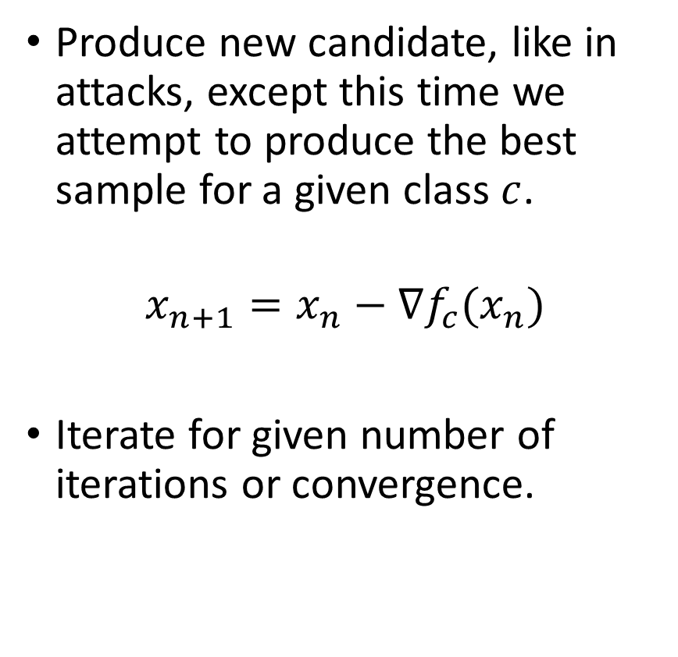
Activation maximization on output classes
Find the input $x^{∗}$, which maximizes a certain output of interest $f_{c}\left(x\right)$, e.g. loss for class c
$$x^{∗}=\arg{\max_{x}\left(f_{c}\left(x\right)\right)}$$
Start from image $x_{0}$ (either noise or maximal candidate in dataset).
Produce new candidate, like in attacks, except this time we attempt to produce the best sample for a given class $c$.
$$x_{n+1}=x_{n}−∇f_{c}(x_{n})$$
Iterate for given number of iterations or convergence.

Slide 42
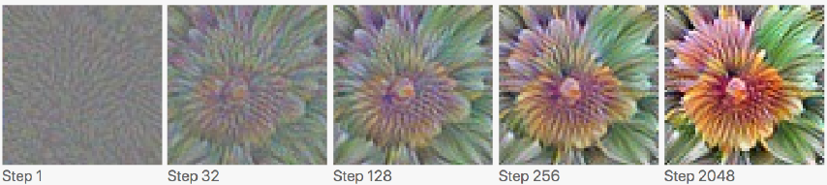
Activation maximization on output classes
Example: what would be the most flower-ish image for a given network?

Slide 43
Activation maximization on layers output
Also works with any layer outputs!
Example: Is layer 4b:409 in ResNet detecting dog features in images?

Slide 44
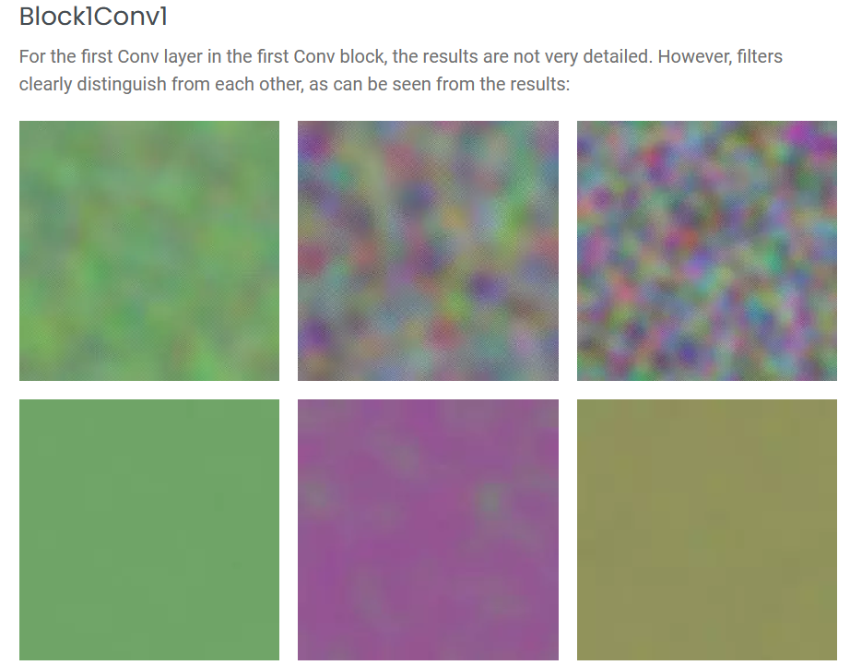
Activation maximization on layers output

Slide 45
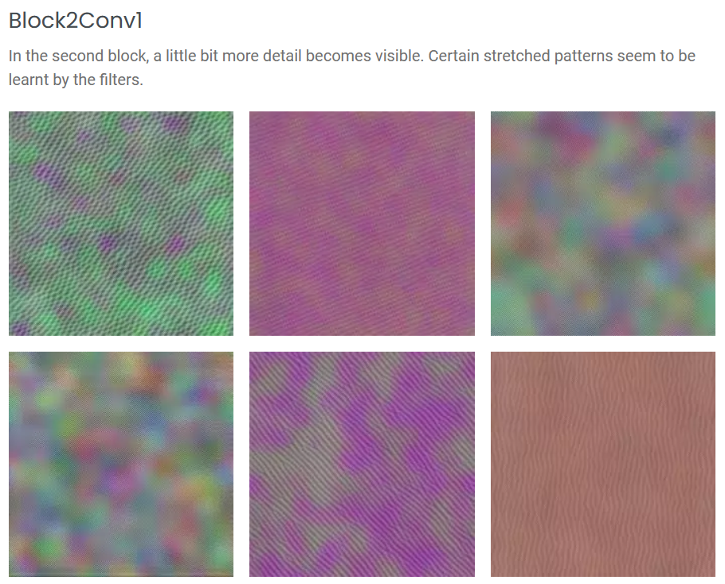
Activation maximization on layers output

Slide 46
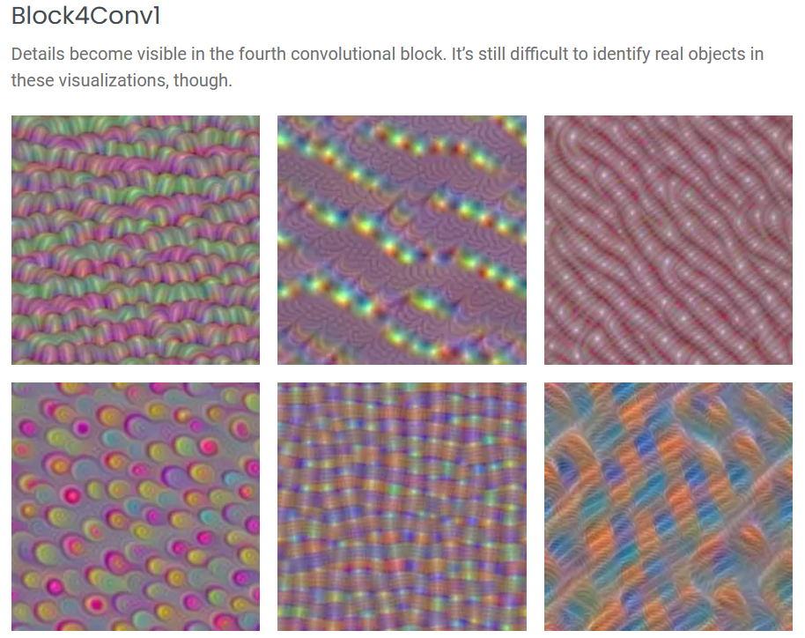
Activation maximization on layers output

Slide 47
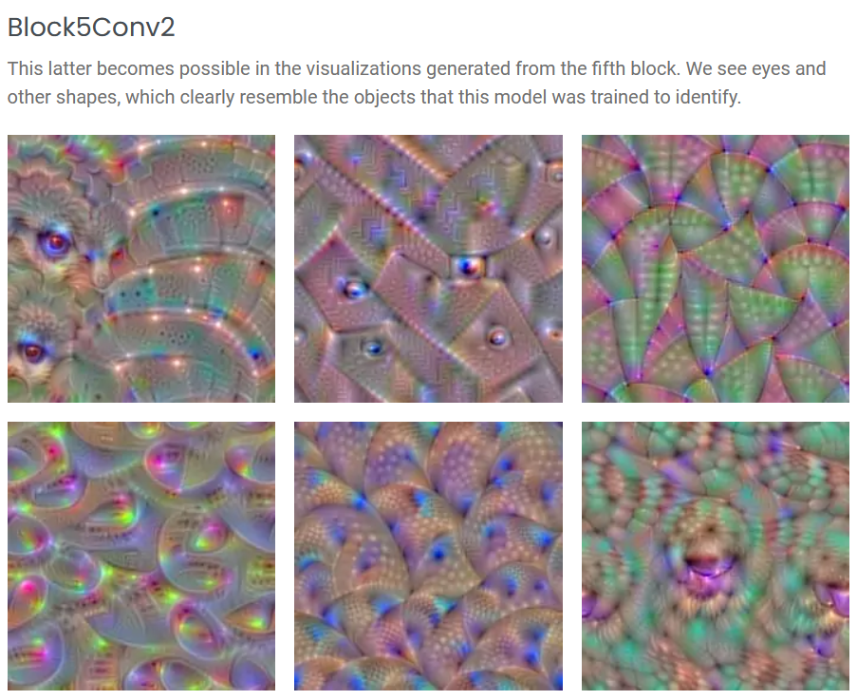
Activation maximization on layers output

Slide 48
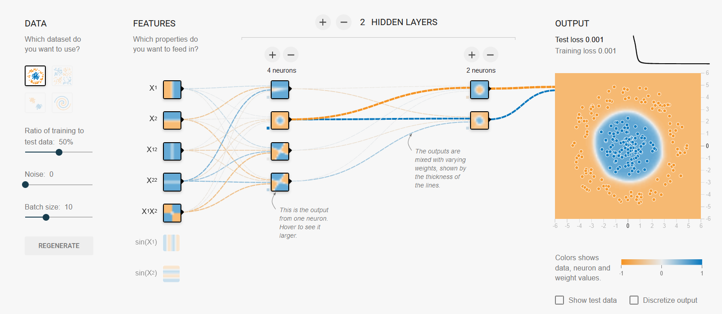
Activation maximization on layers output
Deep Learning Tensorflow Playground: https://playground.tensorflow.org

Slide 49
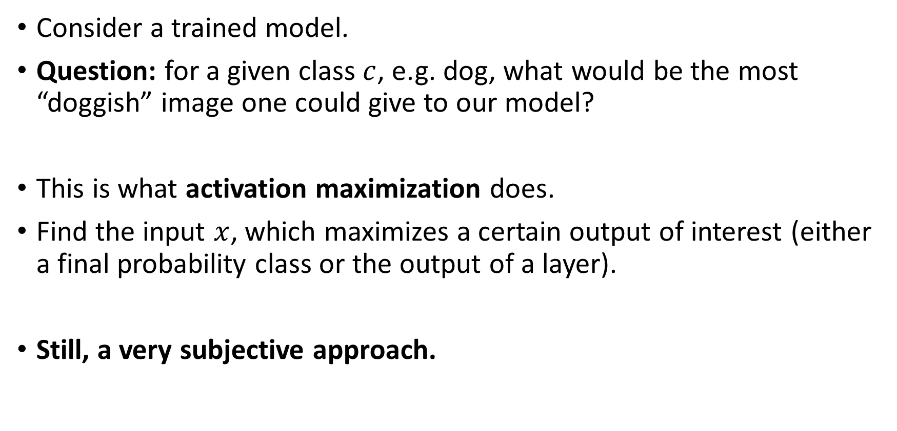
Activation maximization on output classes
Consider a trained model.
Question: for a given class $c$, e.g. dog, what would be the most “doggish” image one could give to our model?
This is what activation maximization does.
Find the input $x$, which maximizes a certain output of interest (either a final probability class or the output of a layer).
Still, a very subjective approach.

Slide 50
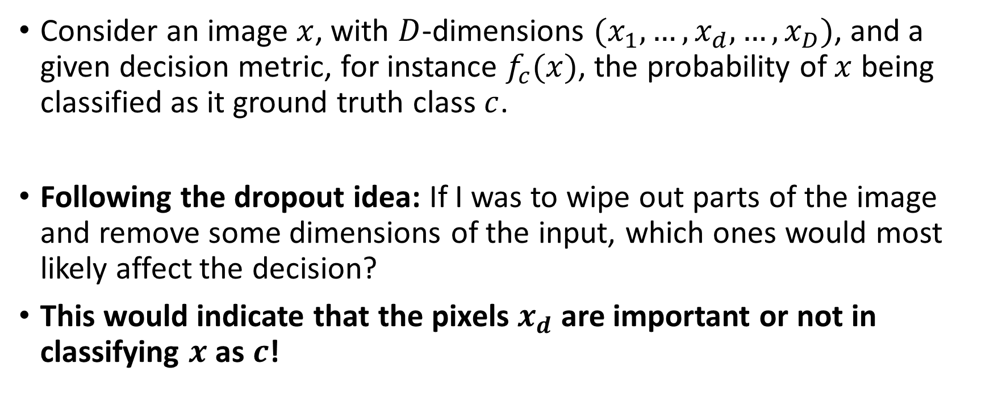
Occlusion-based methods
Consider an image $x$, with $D$-dimensions $(x_{1},…,x_{d},…,x_{D})$, and a given decision metric, for instance $f_{c}(x)$, the probability of $x$ being classified as it ground truth class $c$.
Following the dropout idea: If I was to wipe out parts of the image and remove some dimensions of the input, which ones would most likely affect the decision?
This would indicate that the pixels $x_{d}$ are important or not in classifying $x$ as $c$!

Slide 51
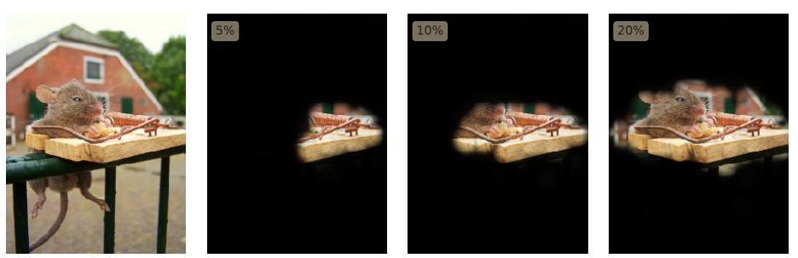
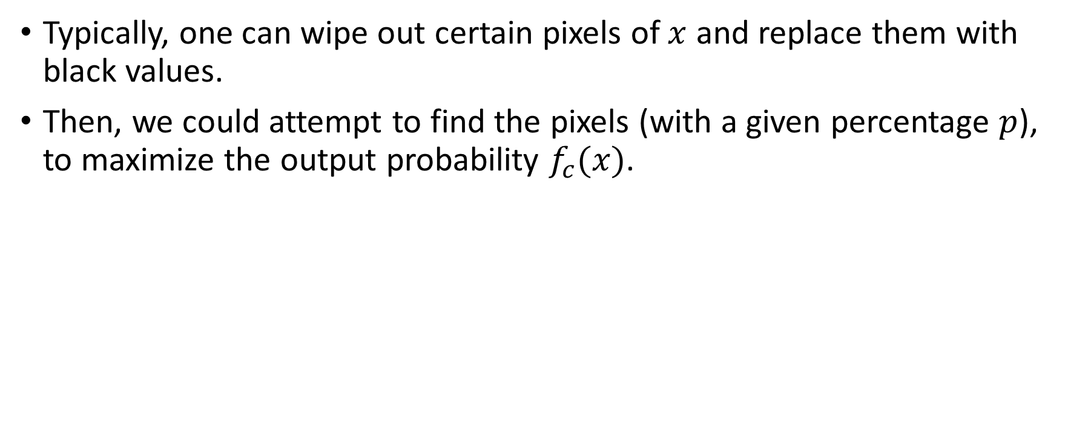
Occlusion-based methods
Typically, one can wipe out certain pixels of $x$ and replace them with black values.
Then, we could attempt to find the pixels (with a given percentage $p$), to maximize the output probability $f_{c}(x)$.

Slide 52

Occlusion-based methods

Slide 53

Occlusion-based methods

Slide 54
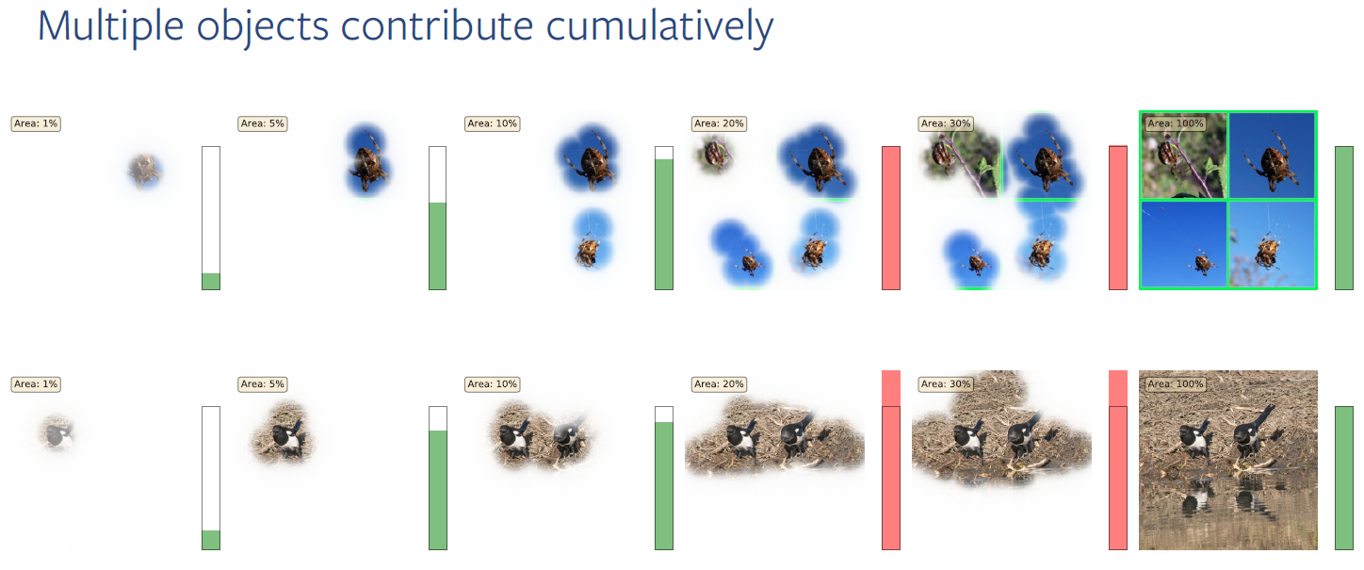
Occlusion-based methods

Slide 55
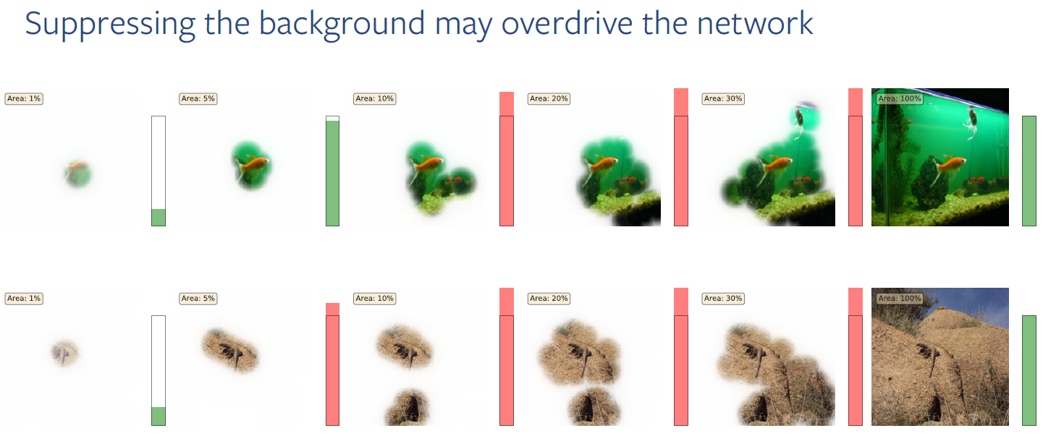
Occlusion-based methods

Slide 56
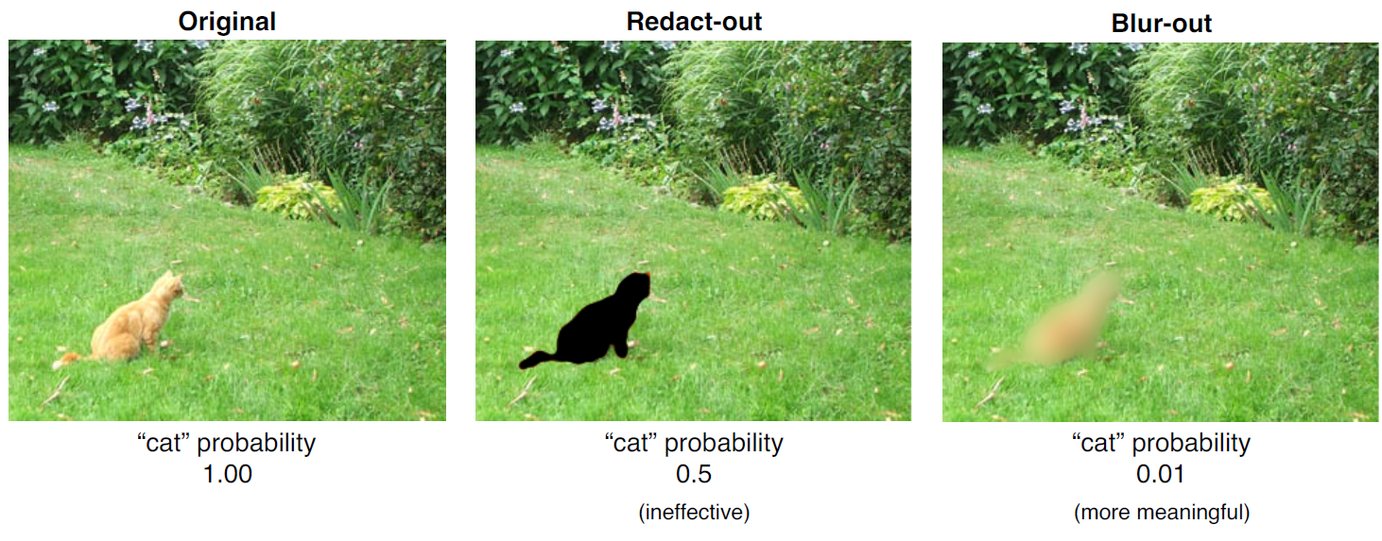
Occlusion-based methods

Slide 57
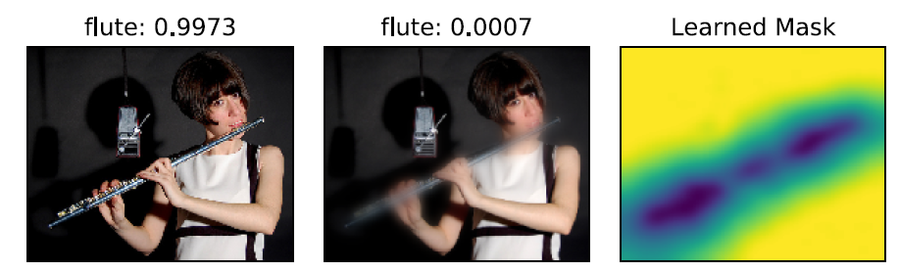
Occlusion-based methods
One could also wonder what could be more meaningful perturbation to the image to make it adversarial in the most efficient manner. For instance, blurring some pixels, rather than others, might have better results.
Finding said pixels, will show the parts of the image that are important for classification.

Slide 58
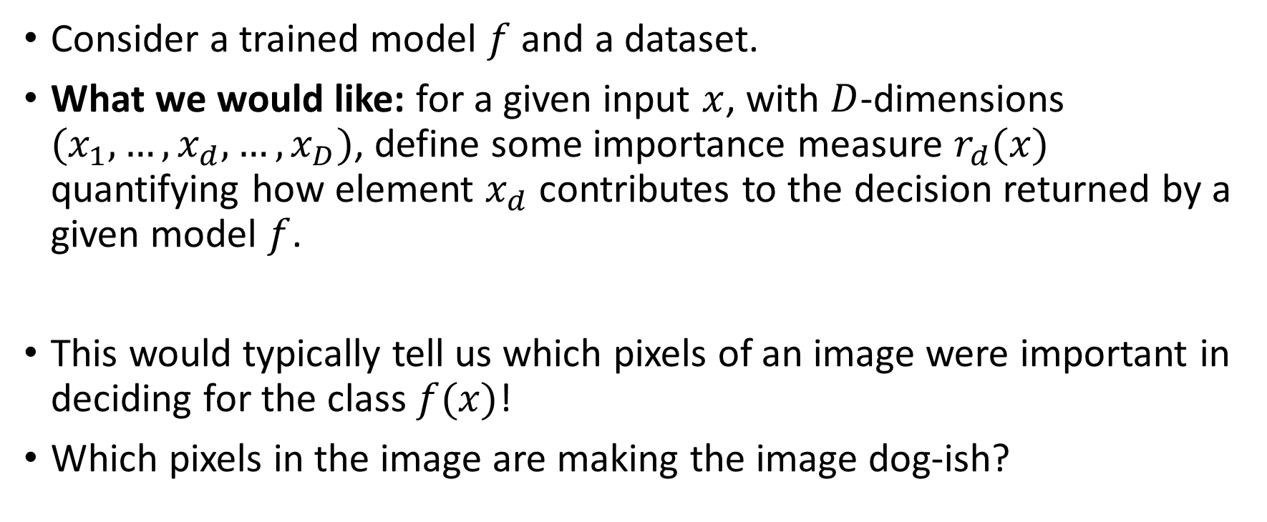
Gradient sensitivity
Consider a trained model $f$ and a dataset.
What we would like: for a given input $x$, with $D$-dimensions $(x_{1},…,x_{d},…,x_{D})$, define some importance measure $r_{d}(x)$ quantifying how element $x_{d}$ contributes to the decision returned by a given model $f$.
This would typically tell us which pixels of an image were important in deciding for the class $f(x)$!
Which pixels in the image are making the image dog-ish?

Slide 59
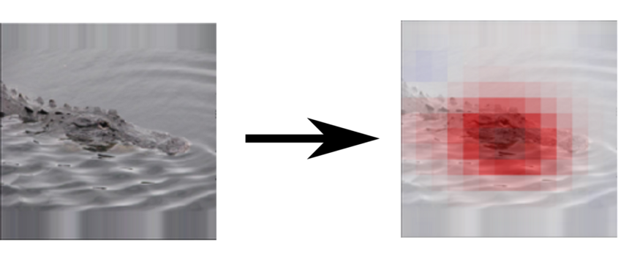
Gradient sensitivity

Slide 60
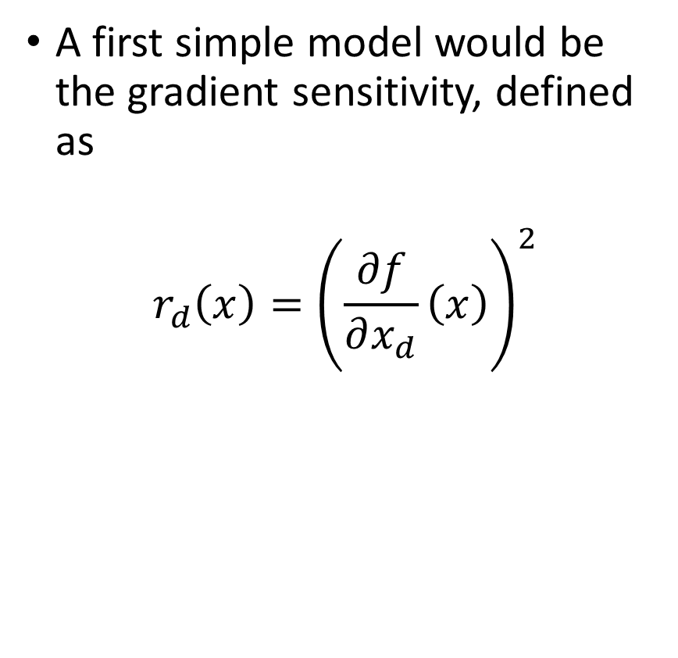
Gradient sensitivity
A first simple model would be the gradient sensitivity, defined as
$$r_{d}\left(x\right)={\left(\frac{∂f}{∂x_{d}}\left(x\right)\right)}^{2}$$

Slide 61
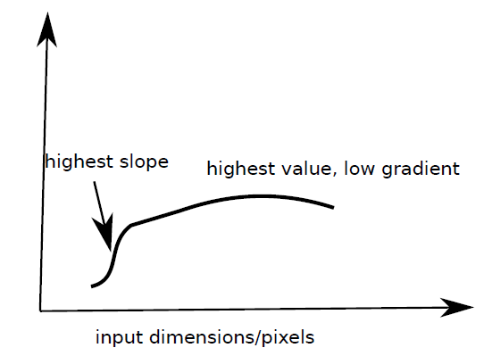
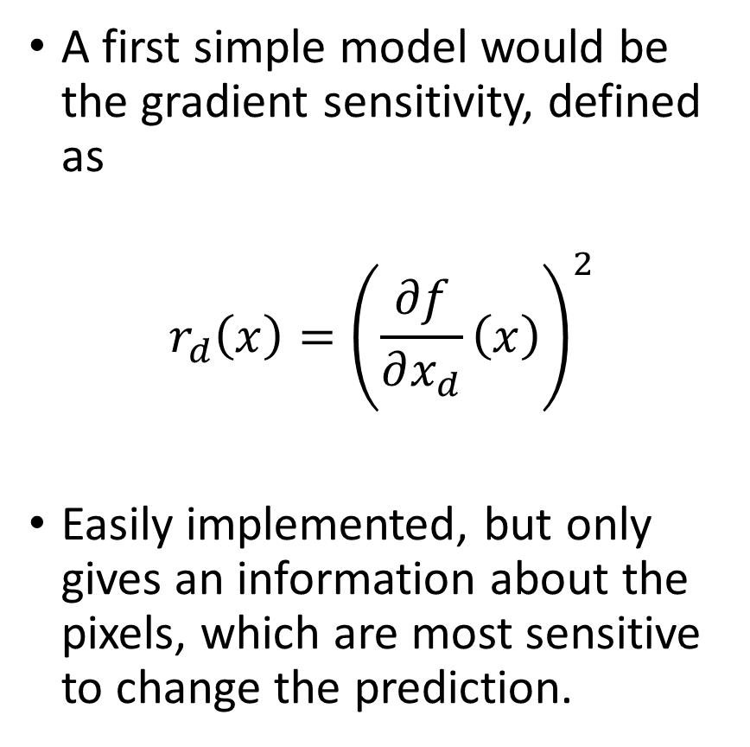
Gradient sensitivity
A first simple model would be the gradient sensitivity, defined as
$$r_{d}\left(x\right)={\left(\frac{∂f}{∂x_{d}}\left(x\right)\right)}^{2}$$
Easily implemented, but only gives an information about the pixels, which are most sensitive to change the prediction.

Slide 62
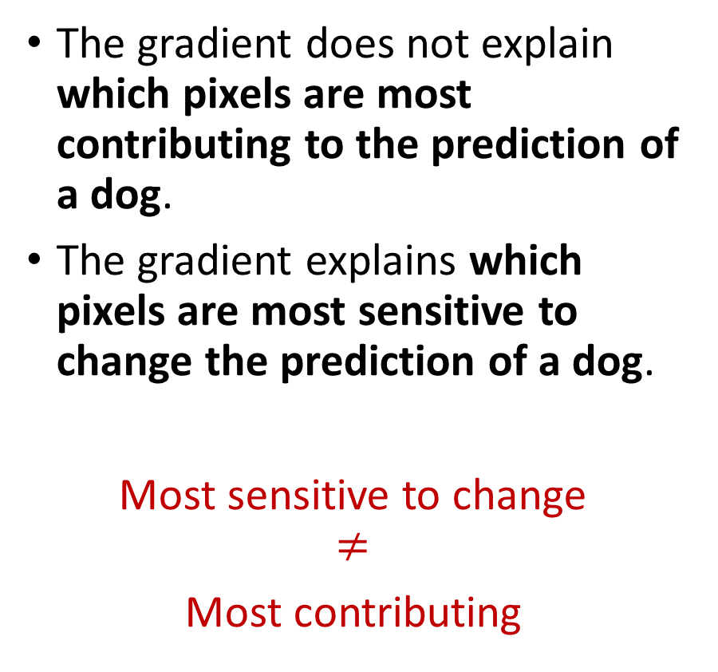
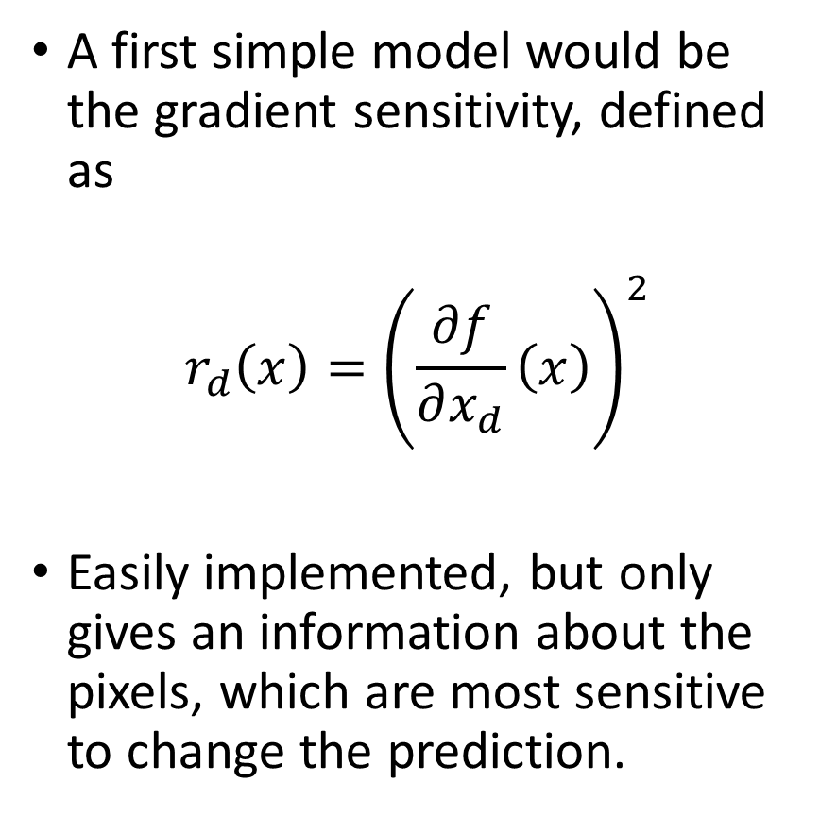
Gradient sensitivity
A first simple model would be the gradient sensitivity, defined as
$$r_{d}\left(x\right)={\left(\frac{∂f}{∂x_{d}}\left(x\right)\right)}^{2}$$
Easily implemented, but only gives an information about the pixels, which are most sensitive to change the prediction.
The gradient does not explain which pixels are most contributing to the prediction of a dog.
The gradient explains which pixels are most sensitive to change the prediction of a dog.
Most sensitive to change $$≠$$
Most contributing

Slide 63
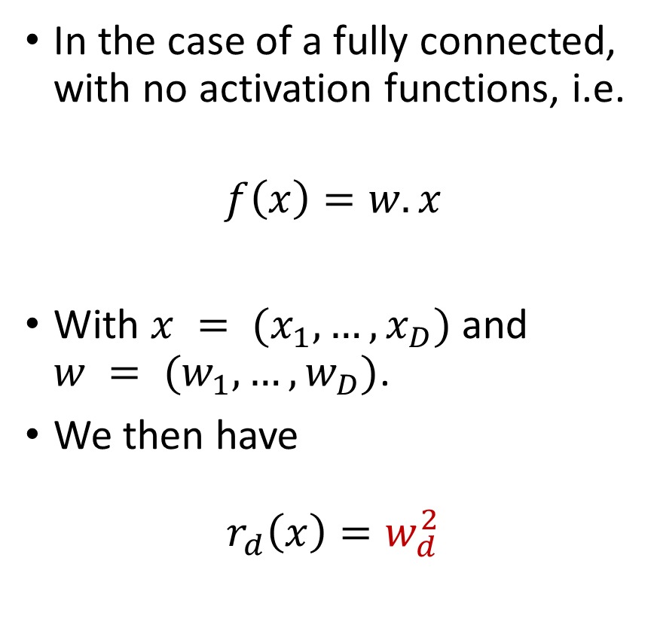
Gradient sensitivity
A first simple model would be the gradient sensitivity, defined as
$$r_{d}\left(x\right)={\left(\frac{∂f}{∂x_{d}}\left(x\right)\right)}^{2}$$
Easily implemented, but only gives an information about the pixels, which are most sensitive to change the prediction.
In the case of a fully connected, with no activation functions, i.e.
$$f\left(x\right)=w.x$$
With $x = (x_{1}, …, x_{D})$and $w = (w_{1},…, w_{D})$.
We then have
$$r_{d}\left(x\right)=w_{d}^{2}$$

Slide 64
Gradient sensitivity
A first simple model would be the gradient sensitivity, defined as
$$r_{d}\left(x\right)={\left(\frac{∂f}{∂x_{d}}\left(x\right)\right)}^{2}$$
Easily implemented, but only gives an information about the pixels, which are most sensitive to change the prediction.
The gradient does not explain which pixels are most contributing to the prediction of a dog.
The gradient explains which pixels are most sensitive to change the prediction of a dog.
Most sensitive to change $$≠$$
Most contributing

Slide 65
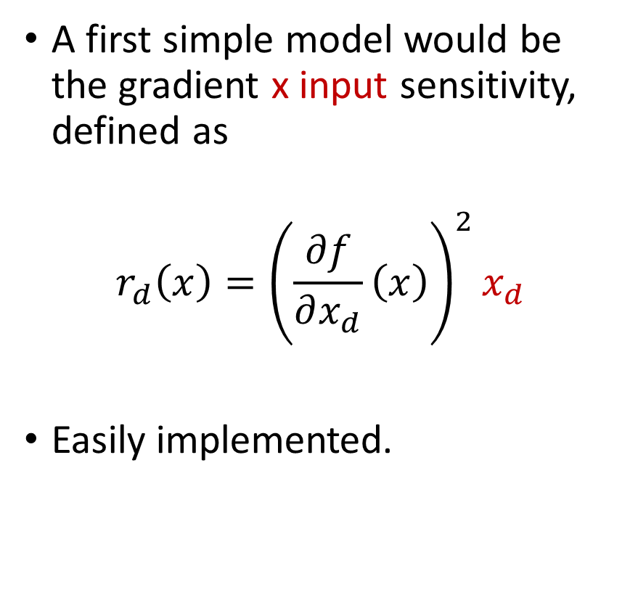
Gradient x input sensitivity
A first simple model would be the gradient x input sensitivity, defined as
$$r_{d}\left(x\right)={\left(\frac{∂f}{∂x_{d}}\left(x\right)\right)}^{2}x_{d}$$
Easily implemented.

Slide 66
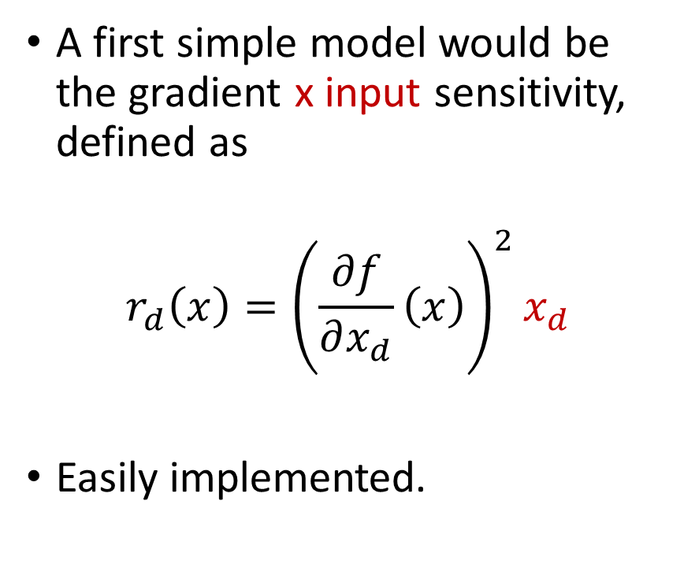
Gradient x input sensitivity
A first simple model would be the gradient x input sensitivity, defined as
$$r_{d}\left(x\right)={\left(\frac{∂f}{∂x_{d}}\left(x\right)\right)}^{2}x_{d}$$
Easily implemented.
Fixes (partially) the previously mentioned problem.
Works well for shallow nets and sigmoid networks.

Slide 67
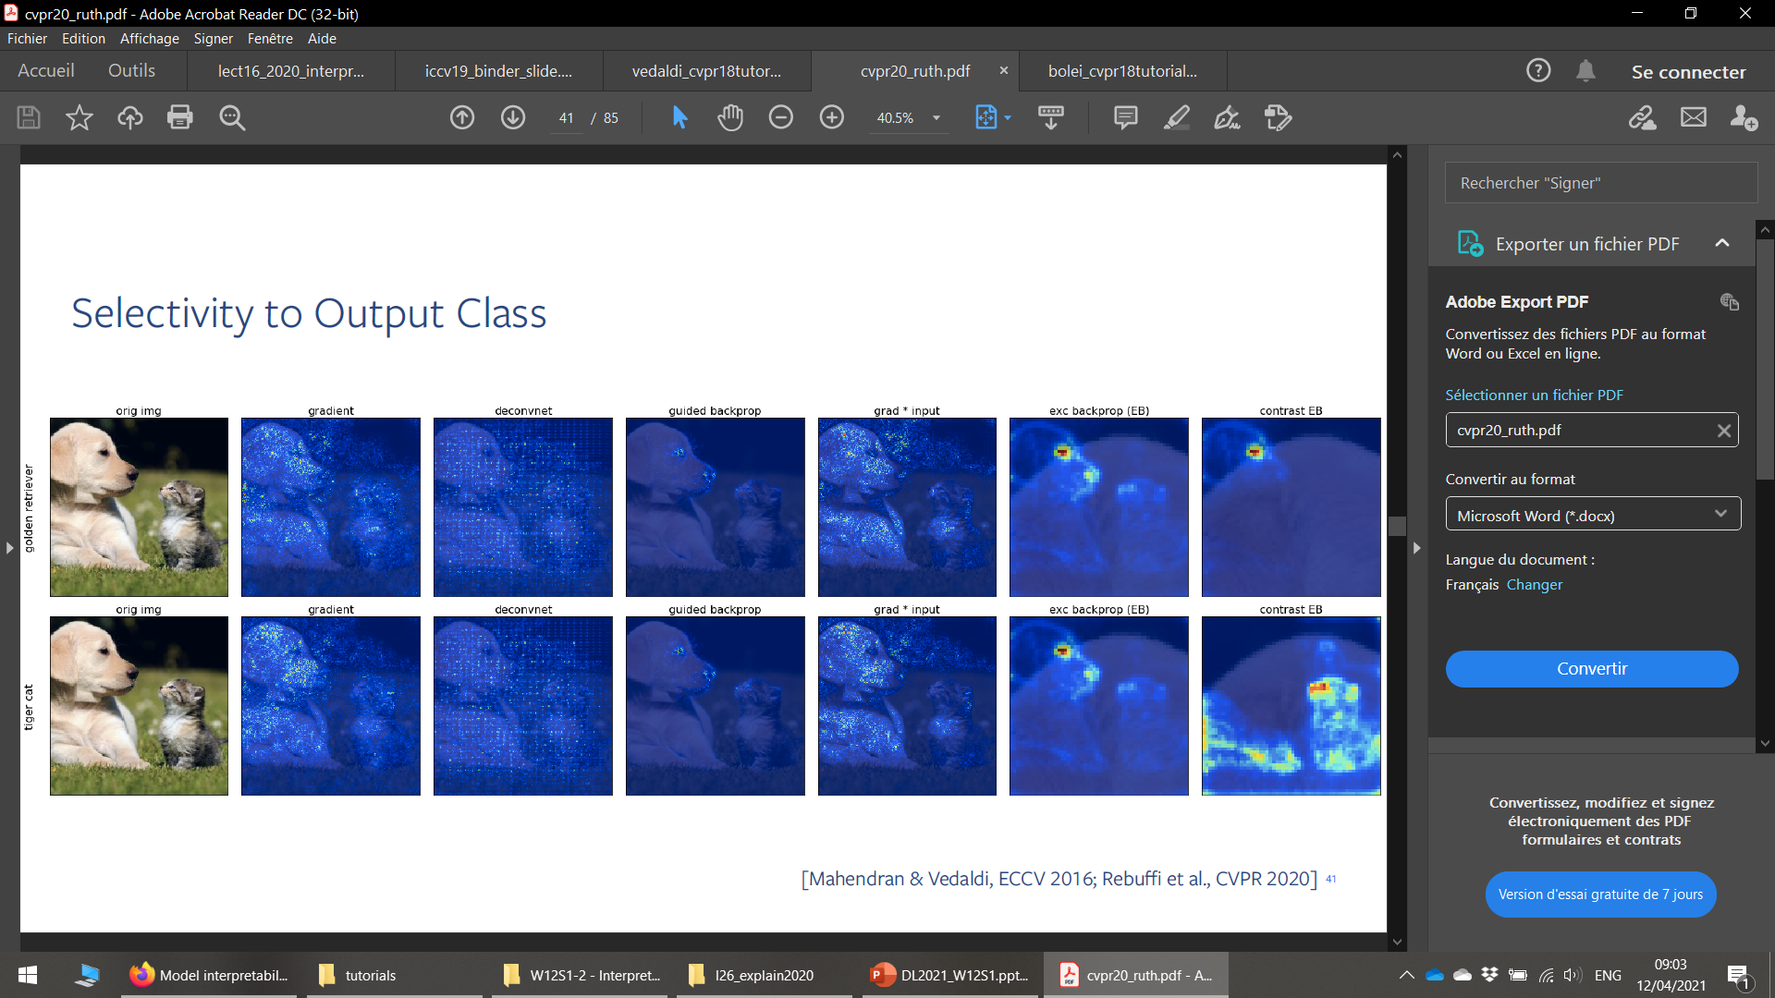
Gradients vs Gradient x Input Sensitivity
Overall, Gradient x Input seems to perform slightly better at identifying subpixels which seem to matter but…
Still very noisy
Strongly affected by activation functions (ReLU?!)
And only showing sensitivity, not the most contributing pixels!
Need to come up with more advanced measures!

Slide 68
Conclusion
In this lecture
Concept of interpretability
Why is interpretability needed
t-SNE method
Analyzing features with activation maximization
Occlusion methods
Gradient and Gradient x Input sensitivity methods
(LIME)
(Guided Backpropagation)
(LRP)

Slide 69
Learn more about these topics
Out of class, for those of you who are curious
About t-SNE http://www.jmlr.org/papers/volume9/vandermaaten08a/vandermaaten08a.pdf And https://lvdmaaten.github.io/publications/papers/JMLR_2008.pdf
About gradient sensitivity https://papers.nips.cc/paper/5422-on-the-number-of-linear-regions-of-deep-neural-networks.pdf And http://proceedings.mlr.press/v70/balduzzi17b/balduzzi17b.pdf.
Playing with occlusion maps https://github.com/akshaychawla/Occlusion-experiments-for-image-segmentation/blob/master/Occlusion%20experiments%20for%20segmentation.ipynb

Slide 70
Learn more about these topics
Out of class, for those of you who are curious
[LIME] Ribeiro et al., “Why Should I Trust You?: Explaining the Predictions of Any Classifier”, 2016. https://arxiv.org/abs/1602.04938
[GuidedBP] Springenberg et al., “Striving for Simplicity: The All Convolutional Net”, 2014. https://arxiv.org/abs/1412.6806
[CAM] Oquab et al., “Is Object Localization for Free? - Weakly-Supervised Learning With Convolutional Neural Networks”, 2016. http://openaccess.thecvf.com/content_cvpr_2015/papers/Oquab_Is_Object_Localization_2015_CVPR_paper.pdf

Slide 71
Learn more about these topics
Out of class, for those of you who are curious
[Grad-CAM] Selvaraju et al., “Grad-CAM: Visual Explanations from Deep Networks via Gradient-based Localization”, 2017. https://arxiv.org/abs/1610.02391
[Grad-CAM++] Chattopadhyay et al., “Grad-CAM++: Improved Visual Explanations for Deep Convolutional Networks”, 2018. https://arxiv.org/abs/1710.11063
[LRP] Bach et al. “On Pixel-Wise Explanations for Non-Linear Classifier Decisions by Layer-Wise Relevance Propagation”, 2015. https://journals.plos.org/plosone/article?id=10.1371/journal.pone.0130140 https://git.tu-berlin.de/gmontavon/lrp-tutorial

Slide 72
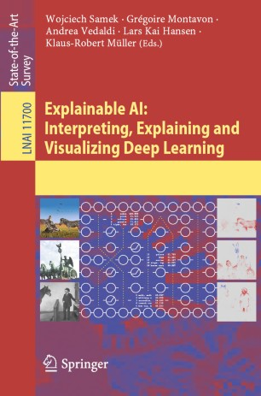
Learn more about these topics
The Bible for interpretability? (as of Early 2021)
Montavon et al., “Layer-Wise Relevance Propagation: An Overview”, 2019.
https://link.springer.com/chapter/10.1007/978-3-030-28954-6_10

Slide 73
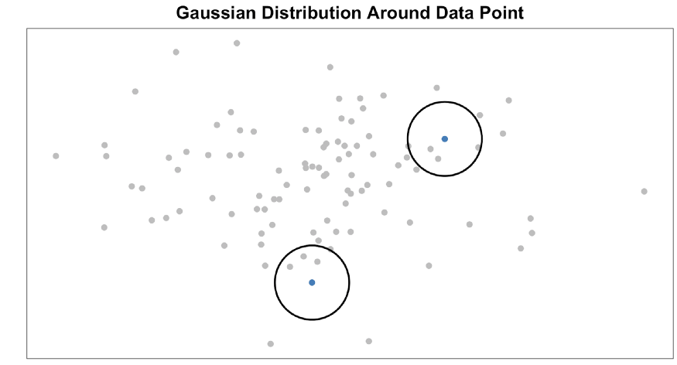
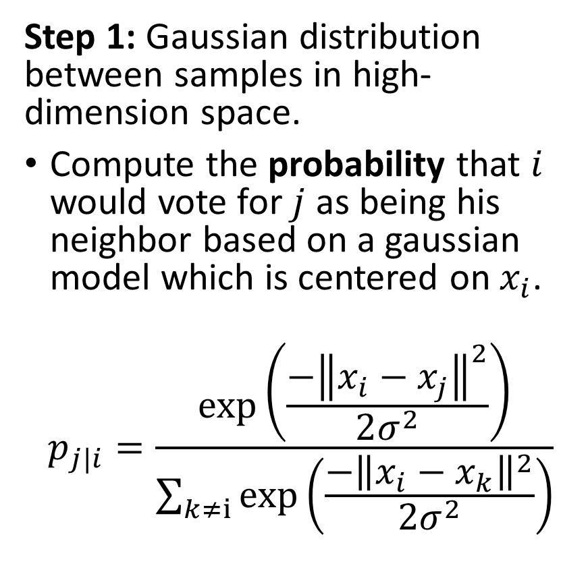
t-SNE implementation
Step 1: Gaussian distribution between samples in high-dimension space.
Compute the probability that $i$ would vote for $j$ as being his neighbor based on a gaussian model which is centered on $x_{i}$.
$$p_{j|i}=\frac{\exp\left(\frac{{−\left\|x_{i}−x_{j}\right\|}^{2}}{2σ^{2}}\right)}{\sum_{k≠i}{\exp\left(\frac{{−\left\|x_{i}−x_{k}\right\|}^{2}}{2σ^{2}}\right)}}$$

Slide 74
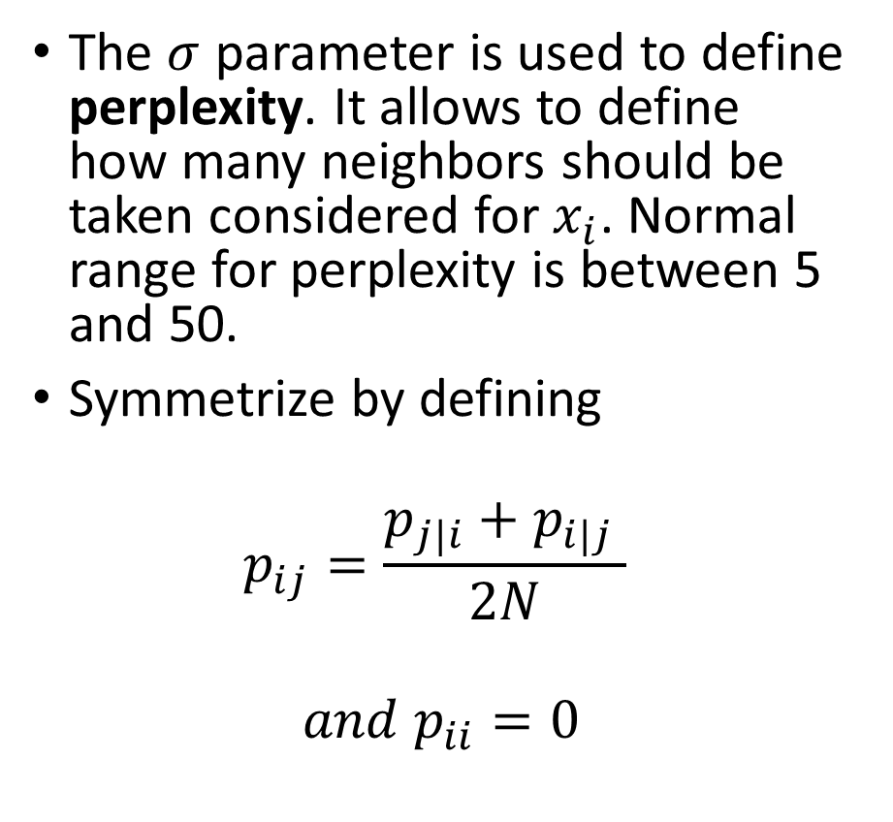
t-SNE implementation
Step 1: Gaussian distribution between samples in high-dimension space.
Compute the probability that $i$ would vote for $j$ as being his neighbor based on a gaussian model which is centered on $x_{i}$.
$$p_{j|i}=\frac{\exp\left(\frac{{−\left\|x_{i}−x_{j}\right\|}^{2}}{2σ^{2}}\right)}{\sum_{k≠i}{\exp\left(\frac{{−\left\|x_{i}−x_{k}\right\|}^{2}}{2σ^{2}}\right)}}$$
The $σ$ parameter is used to define perplexity. It allows to define how many neighbors should be taken considered for $x_{i}$. Normal range for perplexity is between 5 and 50.
Symmetrize by defining
$$p_{ij}=\frac{p_{j|i}+p_{i|j} }{2N}$$
$$and p_{ii}=0$$

Slide 75
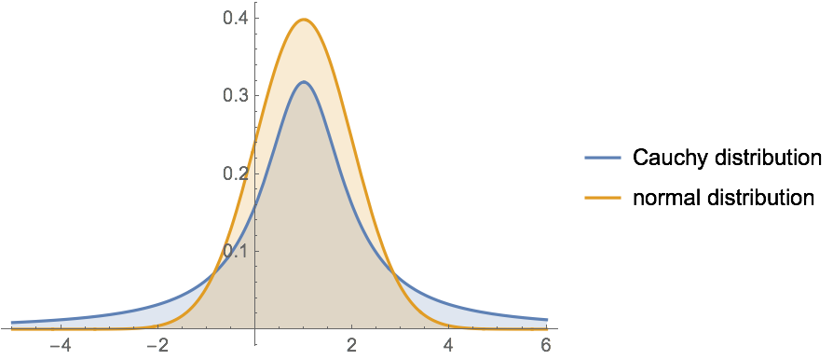
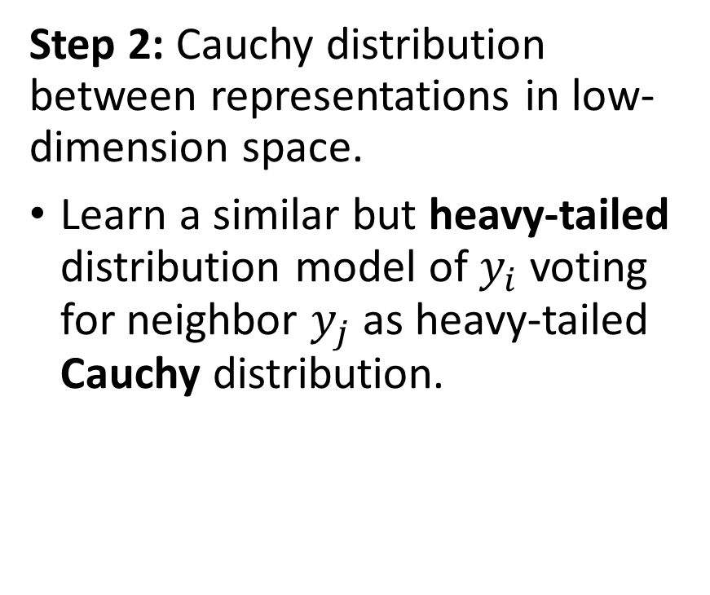
t-SNE implementation
Step 2: Cauchy distribution between representations in low-dimension space.
Learn a similar but heavy-tailed distribution model of $y_{i}$ voting for neighbor $y_{j}$ as heavy-tailed Cauchy distribution.

Slide 76

t-SNE implementation
Definition (Cauchy distribution):
The Cauchy distribution is often used in statistics as the canonical example of a "pathological" distribution, because both its expected value and its variance are undefined.
While similar in shape to the Normal distribution, it is also heavy-tailed.
Its PDF is given by
$$f\left(x,x_{0},γ\right)=\frac{1}{πγ\left(1+{\left(\frac{x−x_{0}}{γ}\right)}^{2}\right)}$$
$f\left(x,x_{0},γ\right)=\frac{1}{πγ}$ ${\left(1+{\left(\frac{x−x_{0}}{γ}\right)}^{2}\right)}^{−1}$

Slide 77
t-SNE implementation
Definition (heavy-tailed distribution):
In probability theory, heavy-tailed distributions are probability distributions whose tails are not exponentially bounded.
They have heavier tails than the normal/exponential distribution, and therefore give higher probabilities to elements far from the center/mean.

Slide 78

t-SNE implementation
Step 2: Cauchy distribution between representations in low-dimension space.
Learn a similar but heavy tailed distribution model of $y_{i}$ voting for neighbor $y_{j}$ as heavy-tailed Cauchy distribution.
$$q_{ij}=\frac{{\left(1{−\left\|y_{i}−y_{j}\right\|}^{2}\right)}^{−1}}{\sum_{\begin{aligned}k,l \\ k≠l\end{aligned}}{{\left(1{−\left\|y_{k}−y_{l}\right\|}^{2}\right)}^{−1}}}$$

Slide 79

t-SNE implementation
Step 2: Cauchy distribution between representations in low-dimension space.
Learn a similar but heavy tailed distribution model of $y_{i}$ voting for neighbor $y_{j}$ as heavy-tailed Cauchy distribution.
$$q_{ij}=\frac{{\left(1{−\left\|y_{i}−y_{j}\right\|}^{2}\right)}^{−1}}{\sum_{\begin{aligned}k,l \\ k≠l\end{aligned}}{{\left(1{−\left\|y_{k}−y_{l}\right\|}^{2}\right)}^{−1}}}$$
Why for the $y_{i}$ use a heavy-tailed probability distribution instead of a Normal one?
This allows a moderate distance in the high-dimensional space to be faithfully modeled by a much larger distance in the map.
As a result, it eliminates the unwanted attractive forces between map points that represent moderately dissimilar datapoints.”

Slide 80

t-SNE implementation

Slide 81

t-SNE implementation
Step 3: Minimize the KL divergence between both distributions.
In order to optimize for $y_{i}$, minimize the KL divergence.
$$q_{ij},i,j=arg\min_{q_{ij},i,j}{[KL\left(p | \left|q\right)\right]}$$
With KL as seen in lecture W11S1.

Slide 82

t-SNE implementation
Step 3: Minimize the KL divergence between both distributions.
In order to optimize for $y_{i}$, minimize the KL divergence.
$$q_{ij},i,j=arg\min_{q_{ij},i,j}{[KL\left(p | \left|q\right)\right]}$$
With KL as seen in lecture W11S1.
We then minimize for $y_{i}$ by computing the gradient of $KL(p||q)$ with respect to $y_{i}$.
Note: Here q depends on $y_{i}$.
This is automatically done with libraries such as sklearn. (For instance, see https://scikit-learn.org/stable/modules/generated/sklearn.manifold.TSNE.html)

Slide 83

The LIME algorithm
We have seen in the gradients sensitivity that decisions made by a linear model is easily explainable
$$f\left(x\right)=\sum_{d}{w_{d}x_{d}}$$
Simply given by weights $w_{d}$!

Slide 84


The LIME algorithm
We have seen in the gradients sensitivity that decisions made by a linear model is easily explainable
$$f\left(x\right)=\sum_{d}{w_{d}x_{d}}$$
Simply given by weights $w_{d}$!
If it has a bias, there is an unexplained component thought, the bias b, which cannot be naturally assigned into contributions of single dimensions d
$$f\left(x\right)=\sum_{d}{w_{d}x_{d}}+b$$

Slide 85

The LIME algorithm
Core idea: given a test sample $x$ learn a locally linear approximation to $f$ around $x$.
$$f\left(x\right)≈A\left(x\right)=\sum_{d}{w_{d}^{′}x_{d}}$$
How to compute a locally linear approximation of $f$?

Slide 86


The LIME algorithm
Core idea: given a test sample $x$ learn a locally linear approximation to $f$ around $x$.
$$f\left(x\right)≈A\left(x\right)=\sum_{d}{w_{d}^{′}x_{d}}$$
How to compute a locally linear approximation of $f$?
Step 1: Generate samples around a given input $x$, denote them ${\left(z_{i}\right)}_{i∈[1,N]}$, as in attacks.
Get their scores $f(z_{i})$ as well.
The samples can be noised versions of the original input $x$, with maximal noise amplitude $ε$.
Or something even fancier (occlusion, blurring, etc.).

Slide 87

The LIME algorithm
Core idea: given a test sample $x$ learn a locally linear approximation to $f$ around $x$.
$$f\left(x\right)≈A\left(x\right)=\sum_{d}{w_{d}^{′}x_{d}}$$
How to compute a locally linear approximation of $f$?
Step 2: Find the combination of weights $w_{d}^{′}$ by training a K-Lasso on the pairs ${\left(z_{i},f\left(z_{i}\right)\right)}_{i∈[1,N]}$.
$$w^{′}=\arg{\min_{w}\left[{\left(f\left(z_{i}\right)−wz_{i}\right)}^{2}+λ\left|w\right|\right]}$$
L1 norm for regularization will encourage weights to be zero.
Select the K-highest weights.

Slide 88

The LIME algorithm
Core idea: given a test sample $x$ learn a locally linear approximation to $f$ around $x$.
$$f\left(x\right)≈A\left(x\right)=\sum_{d}{w_{d}^{′}x_{d}}$$
How to compute a locally linear approximation of $f$?
Step 3: After the regression, use those weight only to obtain the locally linear approximation A.
$$A\left(x\right)=\sum_{d}{w_{d}^{′}x_{d}}$$
Try it for different values of the noise amplitude $ε$, number of weights $K$, and regularization parameter $λ$.

Slide 89


The LIME algorithm
Step 4: The pixel importance score $r_{d}(x)$ is then simply defined as
$$r_{d}\left(x\right)=w_{d}^{′}x_{d}$$
The K value indicates the K most important pixels or dimensions.
and $r_{d}\left(x\right)=w_{d}^{′}x_{d}$ gives a score. (not the most useful though)

Slide 90
The LIME algorithm

Slide 91

The LIME algorithm
The Local Interpretable Model-Agnostic Explanations (LIME) algorithm is a model-agnostic method.
It provides an explanation for any type of model.
The quality of the explanation unfortunately suffers for the generality of this method.
A quick note for good practices
The radius of generated samples $ε$ has a strong effect.
A large sampling radius allows to learn correlations between neighboring data points more than just the gradient.
For a small sampling radius LIME converges to the gradient.

Slide 92


Guided backpropagation
Code idea: do a backpropagation for all fully connected layers $g(z)$, but zero out gradients if
The activation of the neuron is negative, i.e. $g(z) < 0$
Or if the gradient arriving at this neuron . $\frac{∂E}{∂g}\left(z\right)$ is negative, i.e. $\frac{∂E}{∂g}\left(z\right)<0.$

Slide 93
Guided backpropagation

Slide 94

Guided backpropagation
Code idea: do a backpropagation for all layers $g(z)$, but zero out gradients if
The activation of the neuron is negative, i.e. $g(z) < 0$
Or if the gradient arriving at this neuron . $\frac{∂E}{∂g}\left(z\right)$ is negative, i.e. $\frac{∂E}{∂g}\left(z\right)<0.$

Slide 95


Guided backpropagation
Code idea: do a backpropagation for all layers $g(z)$, but zero out gradients if
The activation of the neuron is negative, i.e. $g(z) < 0$
Or if the gradient arriving at this neuron . $\frac{∂E}{∂g}\left(z\right)$ is negative, i.e. $\frac{∂E}{∂g}\left(z\right)<0.$
Reason:
If the activation of the neuron is negative $g(z) < 0$, then $g(z)$is a suppressing neuron. Ignore gradients from suppressing neurons, pass through only gradient signal from firing neurons.
Ignore gradients which decrease the function value, look only at gradients which increase the prediction
It is a heuristic to look only at activating signals and gradients.

Slide 96
Guided backpropagation
Code idea: do a backpropagation for all layers $g(z)$, but zero out gradients if
The activation of the neuron is negative, i.e. $g(z) < 0$
Or if the gradient arriving at this neuron . $\frac{∂E}{∂g}\left(z\right)$ is negative, i.e. $\frac{∂E}{∂g}\left(z\right)<0.$
Takeaways:
It is a heuristic, no mathematical or theoretical underpinning.
We are not really sure what it does.
Looking only at one sign of signals and gradients often gives cleaner heatmaps as a result!

Slide 97

Guided backpropagation

Slide 98
The promised land, a.k.a. decomposition?
Most approaches are trying to avoid, as much as possible to open the black-boxes that Neural Networks are.
Most approaches rely on linear approximations, final layers activations, gradients information, or simply toy with the model.
But none really try to explain it properly.

Slide 99
The promised land, a.k.a. decomposition?
Most approaches are trying to avoid, as much as possible to open the black-boxes that Neural Networks are.
Most approaches rely on linear approximations, final layers activations, gradients information, or simply toy with the model.
But none really try to explain it properly.
The most promising direction (IMO) for interpretability is methodology called Layer-wise Relevance Propagation (LRP).
It is a general approach to explain predictions of AI, which relies on the mathematical Deep Taylor Decomposition of the neural network.

Slide 100

The LRP method (out-of-class)
Core idea: Layer-wise Relevance Propagation (LRP) attempts to calculate the relevance score $r_{d}(x)$ as a decomposition of a prediction, with some additional constraints.
$$f\left(x\right)=\sum_{d}{r_{d}\left(x\right)}$$

Slide 101

The LRP method (out-of-class)
Given a neuron
$$y = g\left( \sum_{d}{w_{d}x_{d}}\right)$$
LRP distributes a quantity, relevance, top-down = from a neuron output $y$, onto the inputs $x_{d}$ of that neuron.
It then repeats the operation on each neuron of each layer.
LRP is somewhat related to the Taylor decomposition of the propagation rule for every single neuron.
LRP results in different rules which can be applied to different types of neural network layers.

Slide 102



The LRP method (out-of-class)
For instance, in the case of a FC layer, use the $ε$-rule to propagate the relevance coefficients R.
For Convolution layers, use the $β$-rule.
Can even get the best of both worlds by combining both the $ε$-rule and the $β$-rule to get the $γ$-rule.

Slide 103

The LRP method (out-of-class)
Mathematical meaning behind these formulas? Unclear, but definitely empirical approximations, heuristics.
Important message: People are trying some formulas to backpropagate the relevance score from the final layers to the first one/inputs with the highest fidelity as possible.
A good PyTorch tutorial for LRP. https://git.tu-berlin.de/gmontavon/lrp-tutorial

Slide 104
The LRP method (out-of-class)
Important message #2: Formulas do not really have a mathematical foundation, but we understand that, intuitively, it should rely on both
the gradients (account for sensitivity of inputs to decision),
and the weights (account for contribution of inputs to decision).
A good PyTorch tutorial for LRP. https://git.tu-berlin.de/gmontavon/lrp-tutorial

Slide 105


The LRP method (out-of-class)

Slide 106

The LRP method (out-of-class)
Gradients
LRP

Slide 107


Gradient x input sensitivity
A first simple model would be the gradient x input sensitivity, defined as
$$r_{d}\left(x\right)={\left(\frac{∂f}{∂x_{d}}\left(x\right)\right)}^{2}x_{d}$$
Easily implemented.
Motivation as heuristic: close to Taylor distribution as explanation for a point $x_{0}$ close to the point $x$ to be explained, if$x_{0}$is chosen orthogonal to the gradient ($∇f\left(x\right).x_{0}=0$).
This is an explanation relative to a point $x_{0}$ such that $f\left(x\right)≈f\left(x_{0}\right)$, which has for classification the same certainty and is close to the point of interest $x$.

Slide 108
A quick word on convolutions
So far, all the algorithms (except for LIME) suggest to play with fully connected layers only, as they are easily interpretable. But not what we use for image processing…
ConvNets have become very efficient lately by outperforming the human eye in visual tasks of different levels of complexity…
But are we able to explain why these networks work so well?
A few attempts in literature exist: CAMs, Grad-CAMs and its variations, LRP, etc.

Slide 109
The idea of CAMs
Class Activation Map (CAM) is a technique that allows highlighting discriminative regions used by a CNN to identify a class in the image.
To be able to build a CAM, CNNs must have a global average pooling layer after the final convolutional layer and then a linear (dense) classification layer.
This means that this method cannot, unfortunately, be directly applied to all CNN architectures.
When used on a non-compatible CNN architecture, the trick to make it work is to plug an existing pre-trained network into a global average pooling layer.

Slide 110

The idea of CAMs
CAM is still powerful and easy to put in place.
Let’s now see how it’s generated for a simple 2D image.

Slide 111
The idea of CAMs

Slide 112
The idea of CAMs
When fed with a 2D color image, a CNN constrained with a global average pooling layer, outputs after the last convolutional layer a set of filters (blue, red, green) that get reduced to a vector after global average pooling.
This vector is then connected to a final classification layer to output the predicted class.

Slide 113

The idea of CAMs
Each filter contains a 2D low-level spatial information about the image that got distilled after layers of successive convolutions.
Each weight ${(w}_{1}, w_{2}, …,w_{n})$ represents the partial importance of each reduced filter in computing the output class.
Filters are adjusted throughout training by the back-propagation algorithm, but preserve the spatial configuration of the image!

Slide 114
The idea of CAMs
A Class Activation Map is, therefore, a sum of a set of spatial 2D activations (i.e. filters) weighted with respect to their relative importance in determining the output class.
When superposed to the initial image, CAM is represented as a heatmap in which highly discriminative regions are painted in red.

Slide 115
The idea of CAMs
Important Note: When a class activation map is generated, it obviously has not the dimension of the initial image!
It has the dimension of the outputs of the last Conv2d layer, which is small!
To be able to use it and superpose it to the input, an upsampling operation (nearest neighbour? 2D-interpolation?) has to be done to resize it.

Slide 116
The idea of CAMs

Slide 117


A quick word on advanced CAMs
Several variations of CAM exist and are, these days, considered the most interesting direction for explaining ConvNets.
Grad-CAM: was built to address some of the inherent issues of CAM, so that it does not need any retraining or architectural modification (pooling needed in CAM!). Grad-CAM backpropagates to calculate and uses a fancier heuristic formula to calculate the pixel relevance score $r_{d}(x)$ based on weights.

Slide 118
A quick word on advanced CAMs
Several variations of CAM exist and are, these days, considered the most interesting direction for explaining ConvNets.
Guided Grad-CAM: Combining the ideas of Guided backpropagation (mentioned earlier) and Grad-CAM together. Best of both worlds type of approach.

Slide 119


A quick word on advanced CAMs
Several variations of CAM exist and are, these days, considered the most interesting direction for explaining ConvNets.
Grad-CAM++: Built on Grad-CAM, provides better visual explanations of CNN model predictions, in terms of better object localization as well as explaining occurrences of multiple object instances in a single image. A weighted combination of the positive partial derivatives of the last convolutional layer feature maps, with respect to a specific class score as weights, is used to generate a visual explanation for the corresponding class label.

Slide 120

A quick word on advanced CAMs

Slide 121

A quick word on advanced CAMs (case of image captioning?)

